Slide 1


Julio Camacho
January 27 2025

Slide 2

Outline
Executive Summary
Introduction
Methodology
Results
Conclusion
Appendix

Slide 3
Executive Summary
This comprehensive analysis of SpaceX's Falcon 9 first stage landing prediction employed a multi-faceted approach combining data science methodologies. The project began with data collection through SpaceX's API and web scraping from Wikipedia, followed by thorough data preprocessing and exploratory data analysis. The analysis utilized interactive visualizations through Folium to map launch sites and their proximity to critical infrastructure, while Matplotlib and Seaborn provided statistical insights into launch success patterns. The machine learning phase compared multiple algorithms, including Logistic Regression, Support Vector Machines, Decision Trees, and K-Nearest Neighbors, with the Decision Tree model achieving the highest accuracy at 88.89%. Key features analyzed included payload mass, orbit type, launch site characteristics, and various technical parameters like grid fins usage and block numbers. The analysis revealed that launch success rates improved significantly over time (from 2013 to 2020), and launch sites were strategically positioned near transportation infrastructure while maintaining safe distances from populated areas. This analysis provides valuable insights for predicting launch success and understanding the cost advantages of SpaceX's reusable rocket technology, which offers launches at $62 million compared to competitors' $165 million.

Slide 4
Introduction
SpaceX has revolutionized space travel through its Falcon 9 rocket program, particularly notable for its cost-effective approach of reusing the first stage of the rocket. While traditional space launches cost around $165 million, SpaceX offers launches at just $62 million, primarily due to their ability to land and reuse the first stage. This significant cost reduction has transformed the commercial space industry and created new opportunities for space exploration and satellite deployment.
The project seeks to understand several critical aspects of SpaceX's operations: predicting the successful landing of the Falcon 9's first stage, identifying the key factors that influence landing success, understanding how geographical and infrastructure elements affect launch site selection, determining the relationship between payload mass and landing success, and analyzing how technological improvements have impacted success rates over time. These insights are valuable not only for SpaceX but also for potential competitors and the broader space industry in understanding the economics and technical requirements of reusable rocket technology.

Slide 5

Section 1

Slide 6
Methodology
The SpaceX Falcon 9 landing prediction project utilized a multi-source ETL pipeline to collect and preprocess data. Launch data was retrieved via SpaceX's REST API and web-scraped from Wikipedia using Python (requests, BeautifulSoup). Preprocessing included handling missing values, standardizing data types, and encoding categorical features using Pandas, resulting in a clean dataset with 80 features stored in CSV and SQLite for analysis.
Exploratory Data Analysis (EDA) involved SQL queries, Matplotlib, and Seaborn for trends and success visualization, while interactive maps and dashboards were created using Folium and Dash. Predictive analysis split the data (80/20), standardized features, and evaluated Logistic Regression, SVM, Decision Trees, and KNN models. GridSearchCV optimized hyperparameters, with the Decision Tree achieving 88.89% accuracy. Model performance was analyzed using confusion matrices and classification reports.

Slide 7
Data Collection
The project collected data through three main methods: SpaceX API integration, web scraping, and data processing. Using the requests library, the SpaceX API provided detailed launch data, including flight numbers, booster versions, payload information, technical specifications, and landing outcomes. Additionally, web scraping with BeautifulSoup4 was employed to extract historical launch records and mission details from Wikipedia's Falcon 9 launch history, supplementing the API data with information not otherwise available.
The data was processed using Pandas DataFrame operations, which included handling missing values in key columns like PayloadMass and LandingPad, standardizing data types, and creating dummy variables for categorical features. The final structured dataset consisted of 80 features covering launch specifications, outcomes, and engineered variables. This comprehensive dataset was stored in both CSV format and a SQLite database, forming a robust foundation for further analysis.

Slide 8
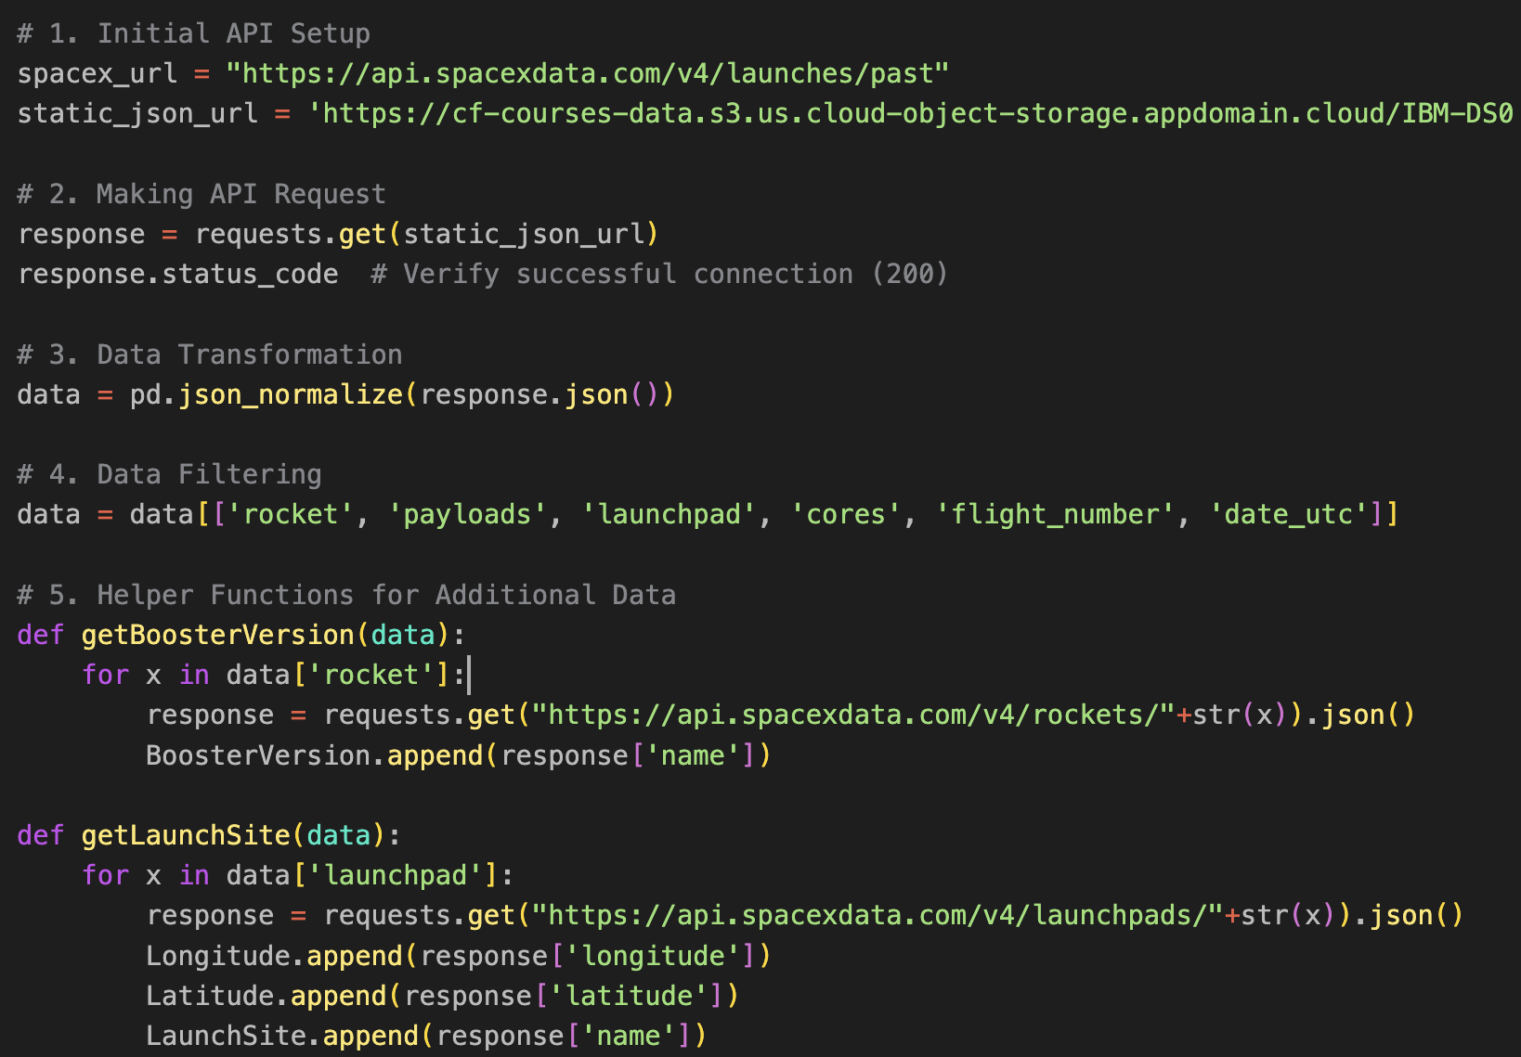
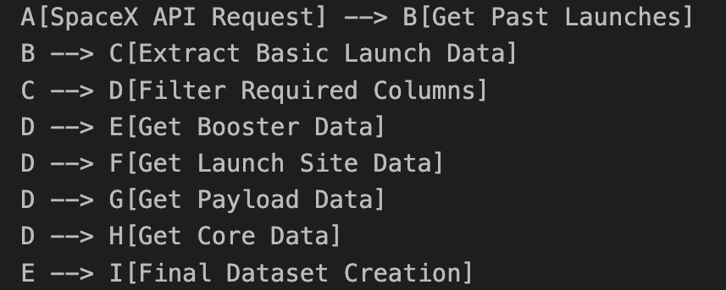
Data Collection – SpaceX API
Add the GitHub URL of the completed SpaceX API calls notebook (must include completed code cell and outcome cell), as an external reference and peer-review purpose

Slide 9
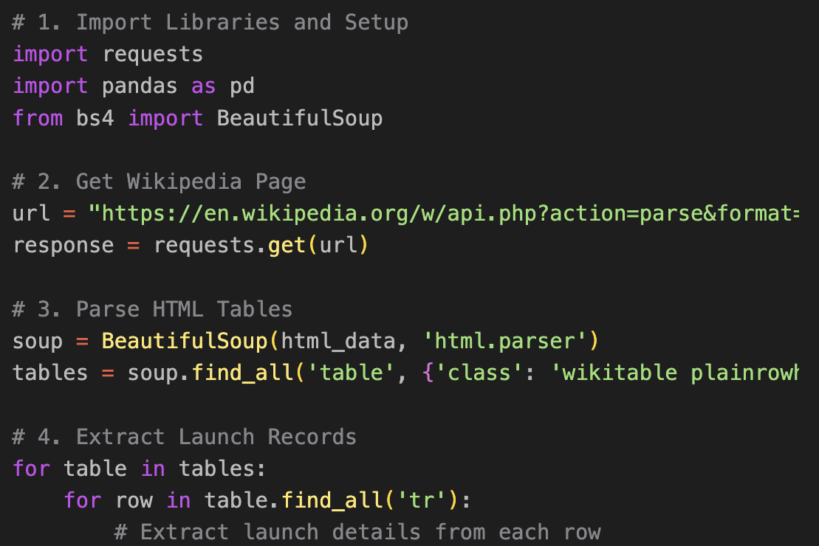
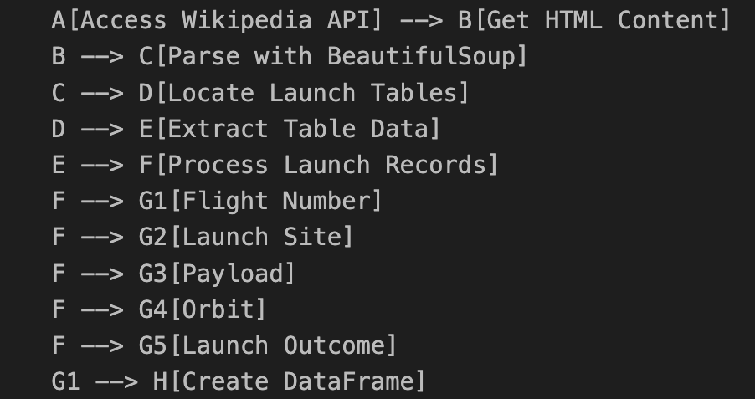
Data Collection - Scraping
Add the GitHub URL of the completed web scraping notebook, as an external reference and peer-review purpose

Slide 10
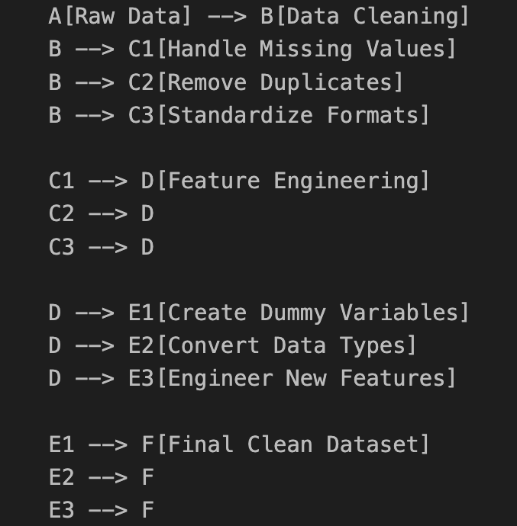
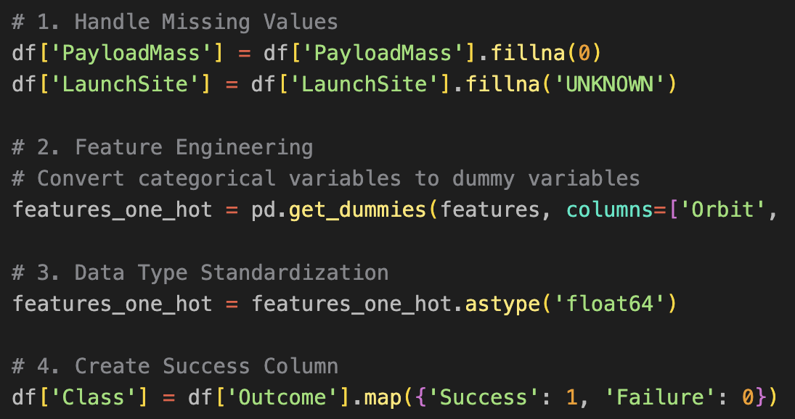
Data Wrangling

Slide 11
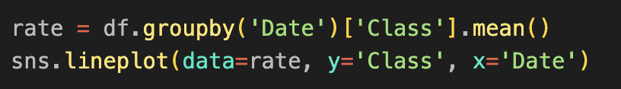
EDA with Data Visualization
1. Flight Number vs. Payload Mass (Scatter Plot with Categorical Hue): To visualize how payload mass and flight experience affect landing success rates. Shows that success rates improved with more flights, even with heavier payloads.
2. Flight Number vs. Launch Site (Categorical Plot): To analyze success patterns across different launch sites over time. Reveals site-specific success trends.
3. Payload Mass vs. Launch Site (Scatter Plot): To understand payload capacity limits at different sites. Shows VAFB-SLC has no heavy payload (>10000kg) launches.
4. Success Rate by Orbit Type (Bar Chart): To compare success rates across different orbit types. Identifies which orbits have higher success rates.
5. Launch Success Yearly Trend (Line Plot): To track improvement in success rates over time. Shows increasing success trend from 2013-2020.
Add the GitHub URL of your completed EDA with data visualization notebook, as an external reference and peer-review purpose

Slide 12
EDA with SQL
Launch Sites Query: Retrieved unique launch site names used by SpaceX.
CCA Launch Sites Query: Found first 5 launches from sites beginning with "CCA”.
Mission Outcomes Query: Counted total successful vs failed missions.
-> Results: 98 successes, 1 failure, 2 partial successes
Maximum Payload Query: Identified boosters that carried heaviest payloads.
2015 Monthly Launches Query: Analyzed launches by month in 2015. Included landing outcomes and booster versions.
Landing Outcomes Ranking Query: Ranked landing outcomes by frequency.
-> Top results: 10 no attempts, 5 drone ship successes, 5 drone ship failures.
Add the GitHub URL of your completed EDA with SQL notebook, as an external reference and peer-review purpose

Slide 13
Build an Interactive Map with Folium
We utilized the Folium library to generate Circle objects, which we used to highlight the Launch Sites on the map by coloring them red. For each Launch Site, we created a cluster containing markers that pinpoint the exact coordinates of rocket launches, indicating whether the launch was successful or failed.
Clusters were employed to enhance visual clarity, as they group closely located markers together, making the map more aesthetically pleasing and easier to interpret. Additionally, we used Polyline objects to draw connections between Launch Sites, highways, coastlines, and nearby cities, illustrating their relative proximity.
Add the GitHub URL of your completed interactive map with Folium map, as an external reference and peer-review purpose

Slide 14
Build a Dashboard with Plotly Dash
First, we populate the dropdown menu with a list of launch sites, allowing users to select the one they want to explore. Upon selection, the app displays a Pie Chart that visualizes the success versus failure rates for the chosen site. Additionally, there is an "ALL" option, enabling users to view and compare the success rates across all launch sites.
Below the Pie Chart, a Scatter Plot is presented, illustrating the relationship between Payload Mass and Success Rate. This plot includes a range slider, allowing users to adjust the payload mass range and observe how it impacts the success rate of launches.
Add the GitHub URL of your completed Plotly Dash lab, as an external reference and peer-review purpose

Slide 15
Predictive Analysis (Classification)
We downloaded the dataset and standardized the data to ensure consistency. After splitting the data into training and testing sets, we developed several models, including Logistic Regression, Support Vector Machine, Decision Tree Classifier, and K-Neighbors Classifier. To optimize these models, we applied GridSearch for hyperparameter tuning. Based on the results, the Decision Tree Classifier emerged as the best-performing model, achieving an accuracy of 0.88.
Add the GitHub URL of your completed predictive analysis lab, as an external reference and peer-review purpose

Slide 16
Results: Exploratory Data Analysis
This analysis explores SpaceX Falcon 9 first-stage landing predictions, highlighting key findings. As flight numbers increased, successful landings became more frequent, even with heavier payloads, indicating improved reliability. Multiple launch sites were used, with VAFB-SLC notably handling no payloads over 10,000 kg. Orbit success rates varied: Low Earth Orbit (LEO) showed a correlation between success and flight number, while Geosynchronous Transfer Orbit (GTO) did not. Yearly trends revealed a steady rise in success rates from 2013 to 2020, reflecting SpaceX’s technological advancements.
Using SQL, deeper insights were uncovered. The first successful ground pad landing occurred on December 22, 2015. Boosters with payloads between 4,000 and 6,000 kg achieved successful drone ship landings, and the mission success rate was high, with 98 successes and only one in-flight failure. The F9 B5 series carried the maximum payload mass, and landing outcomes between 2010 and 2017 included a mix of successful and failed attempts.
Overall, SpaceX demonstrated clear technological progress, with landing success rates improving over time. Payload mass influenced outcomes but wasn’t the sole factor, and the company achieved high mission success despite the experimental nature of booster recovery. This data underscores SpaceX’s success in developing reusable rocket technology and advancing space exploration.

Slide 17
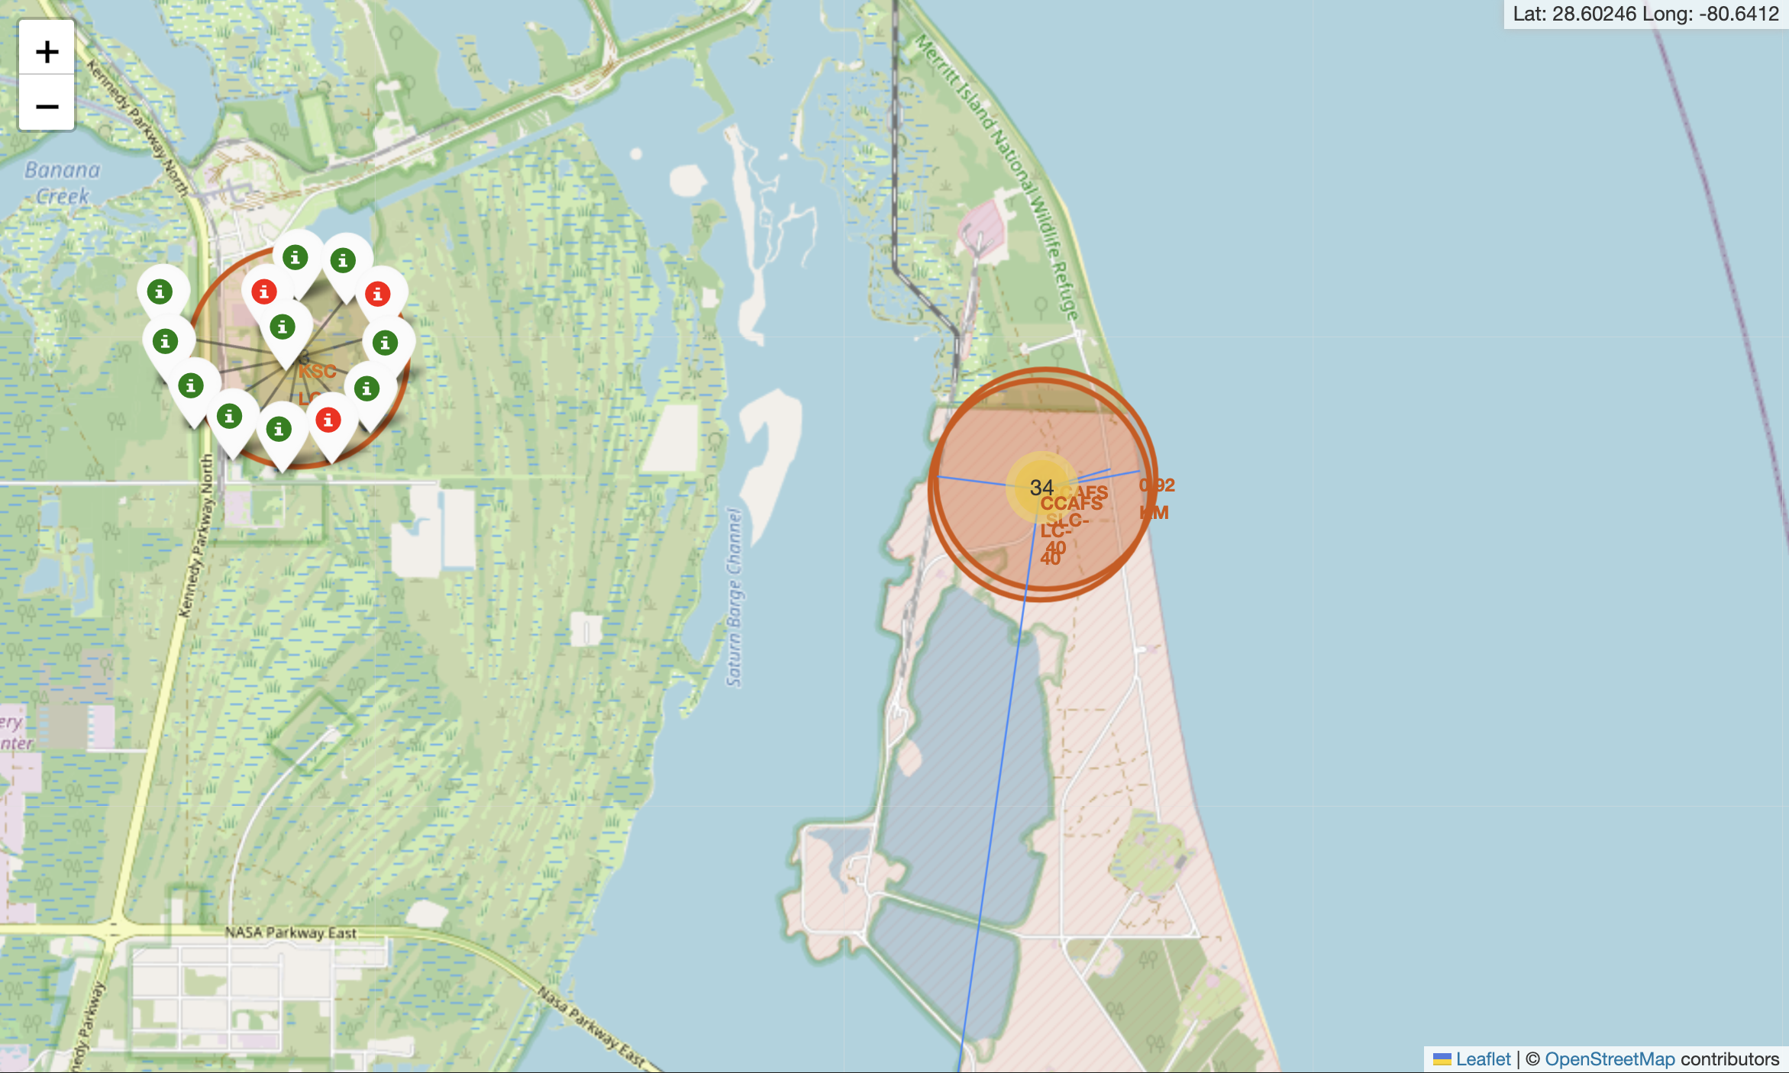
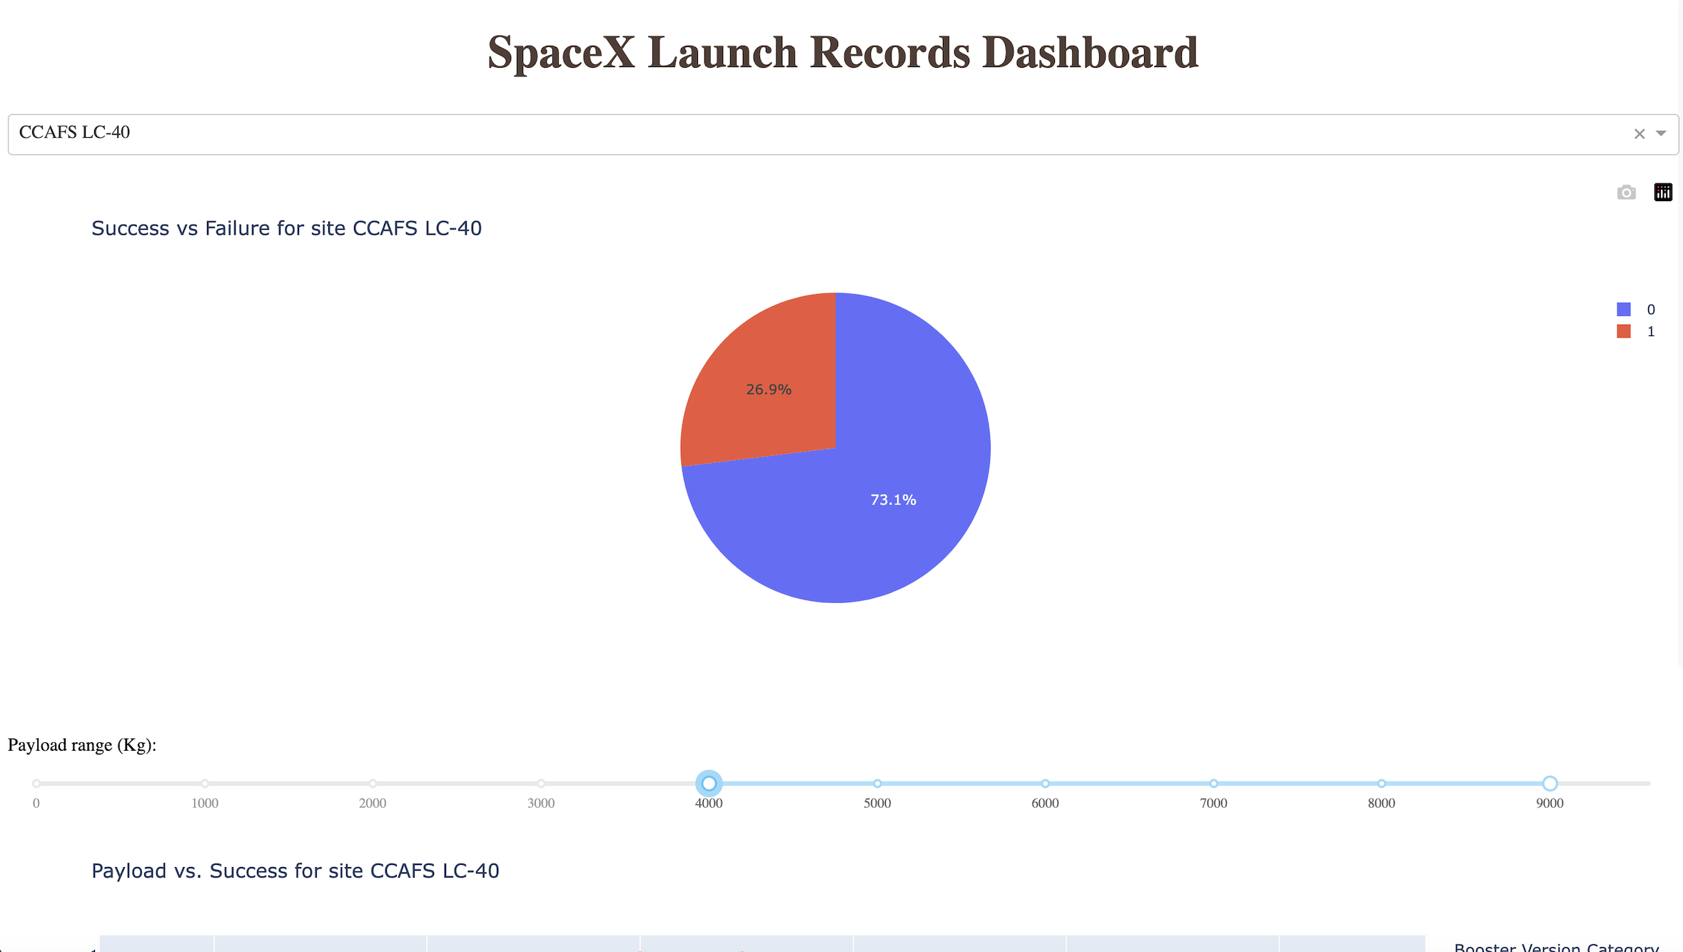
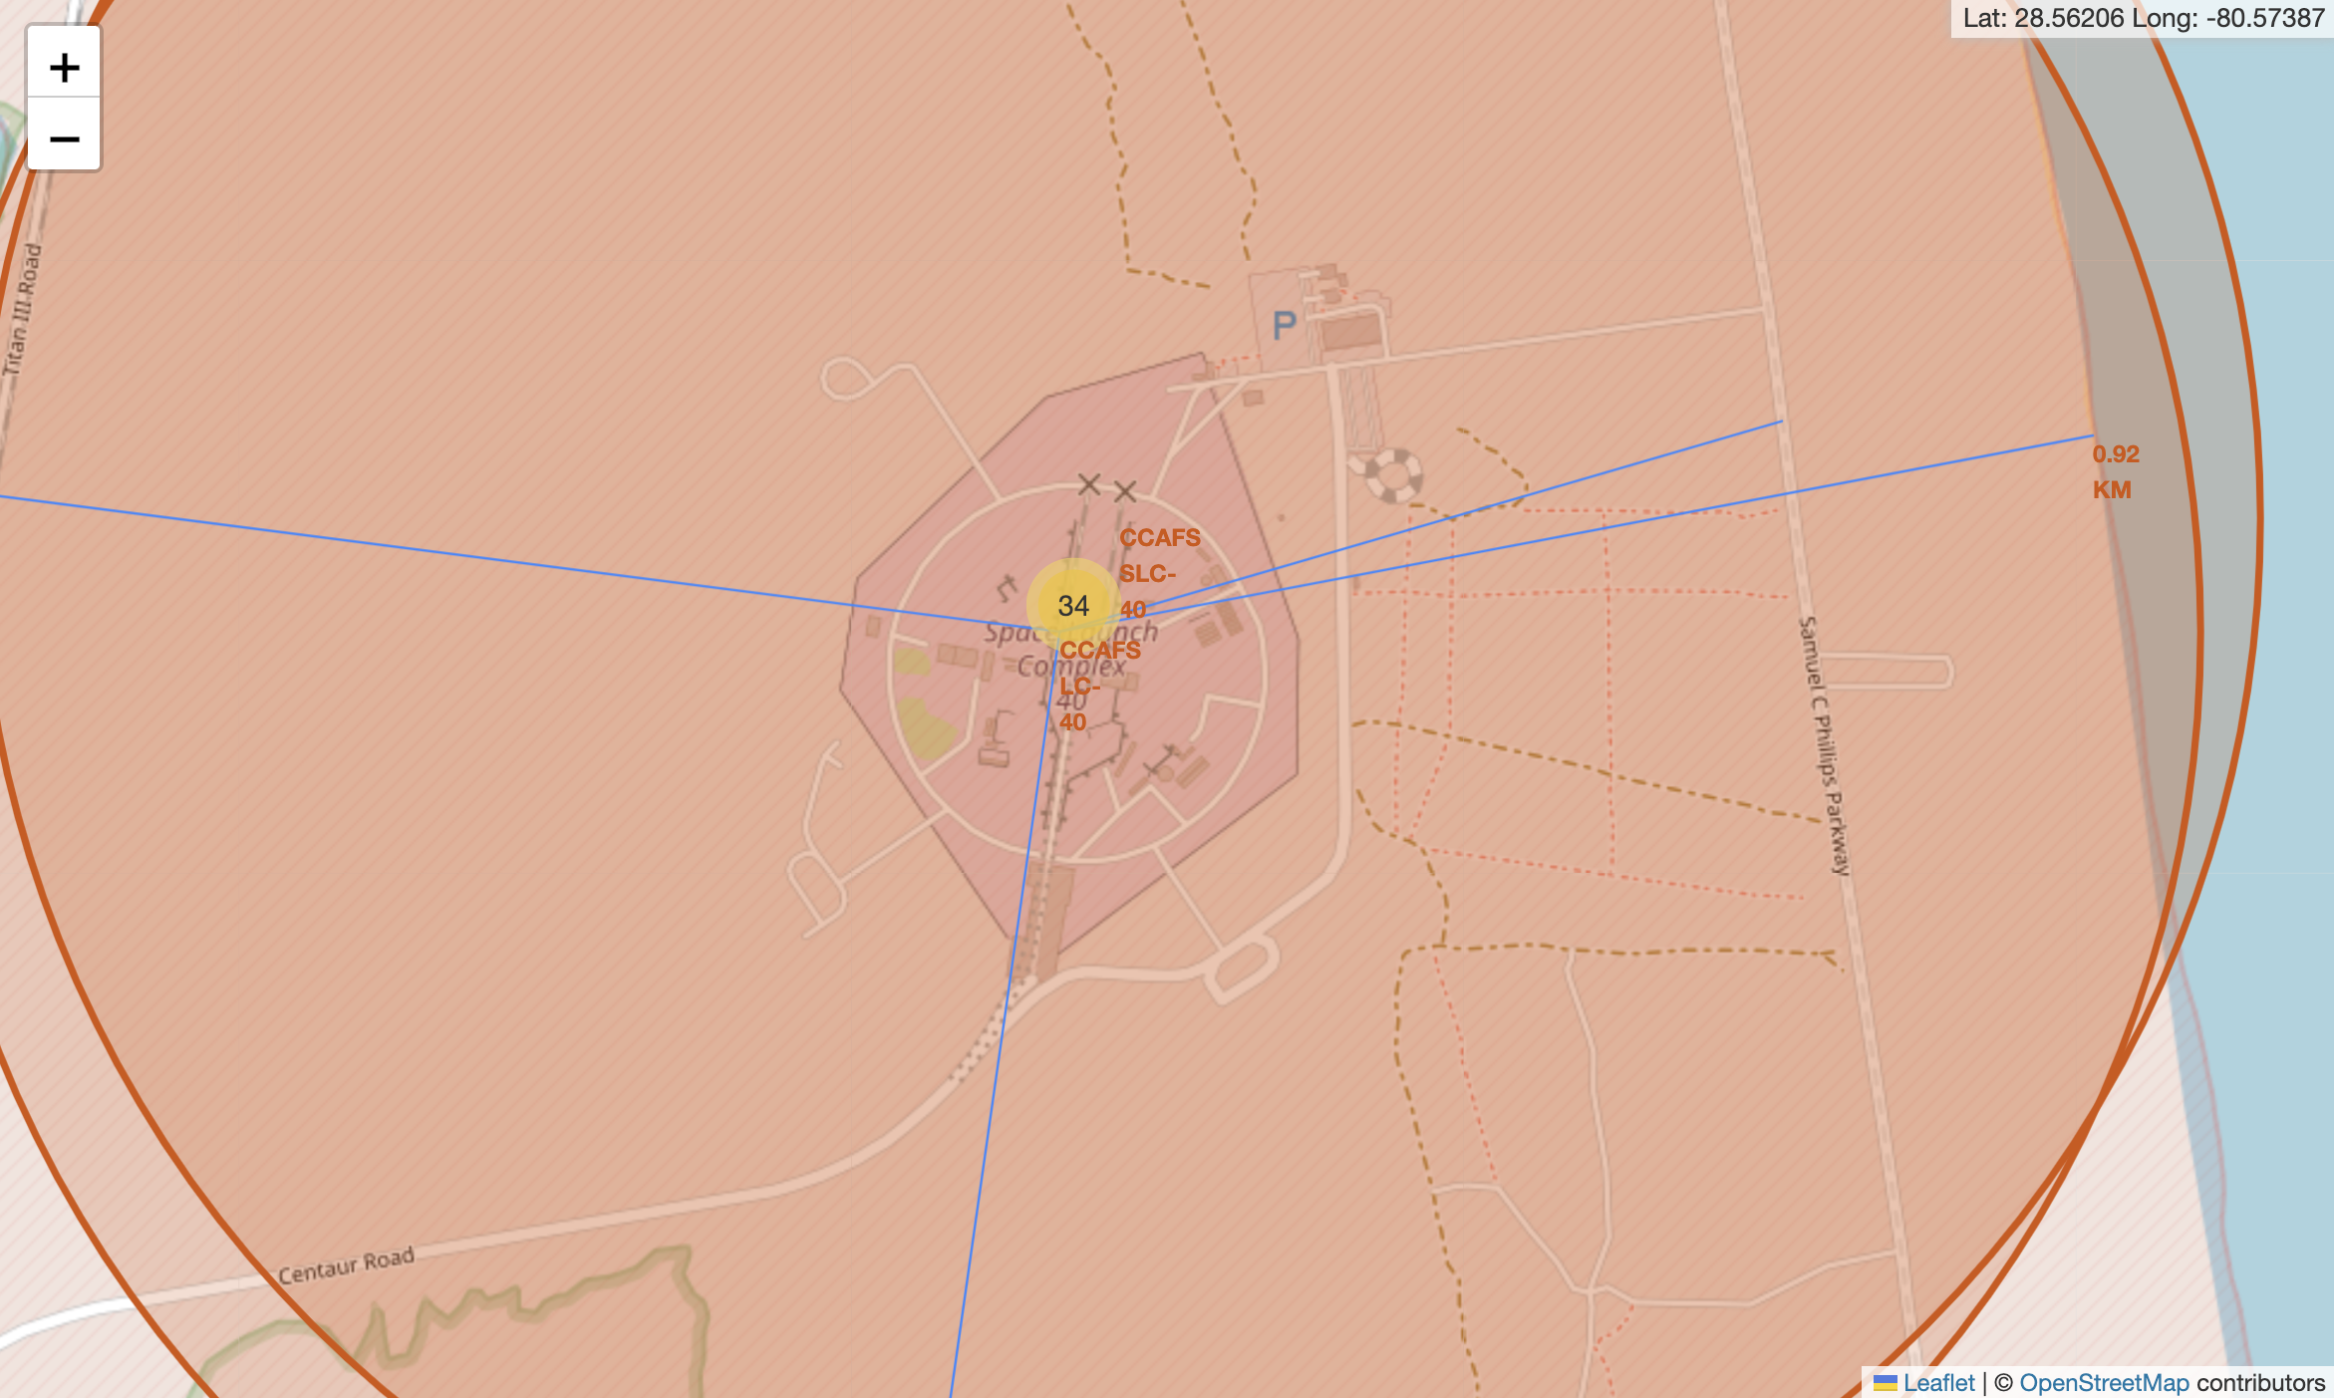
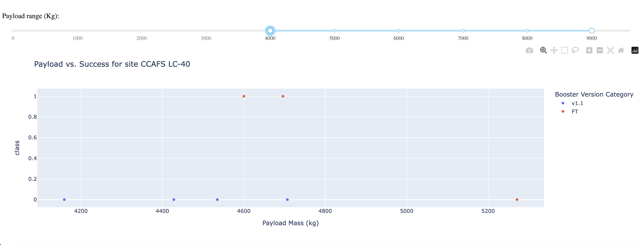
Results: Interactive analytics demo in screenshots
FOLIUM SCREENSHOTS
DASH SCREENSHOTS

Slide 18
Results: Predictive Analysis Results
The model performance analysis revealed that the Decision Tree classifier achieved the highest accuracy of 88.89% on the test data, outperforming Logistic Regression, Support Vector Machine (SVM), and K-Nearest Neighbors (KNN), which all scored 83.33%. This ~5.56 percentage point improvement highlights the Decision Tree’s ability to capture non-linear relationships in the data. All models underwent extensive hyperparameter tuning using GridSearchCV with 10-fold cross-validation, with the Decision Tree optimized for parameters like tree depth, splitting criteria, and minimum samples per leaf. The consistent performance of the other models at 83.33% establishes a reliable baseline, while the high accuracy across all models suggests well-structured data and effective feature selection. The test set, though small with 18 samples, provided meaningful results due to the consistency and clear superiority of the Decision Tree. Overall, the Decision Tree emerges as the best choice for this landing prediction task, offering significant value for practical applications like SpaceX’s landing success predictions.

Slide 19

Section 2

Slide 20
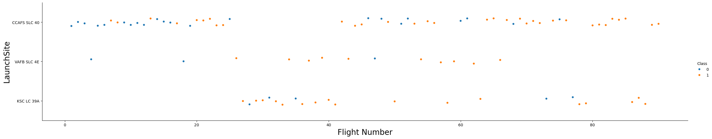
Flight Number vs. Launch Site
CCAFS SLC-40 was utilized for the earliest flights, characterized by lower flight numbers, and displayed a mix of successful and failed landings. In contrast, KSC LC-39A, which began operations later with higher flight numbers, demonstrated a higher frequency of successful landings. VAFB SLC-4E, though used less frequently, also exhibited improving success rates in later flights. Overall, there is a clear trend of increasing successful landings (Class 1) as flight numbers rise, indicating that SpaceX significantly enhanced its landing capabilities over time. This plot not only highlights the temporal progression of launches at different sites but also underscores SpaceX’s steady improvement in landing success rates, showcasing their technological advancements and growing expertise.

Slide 21
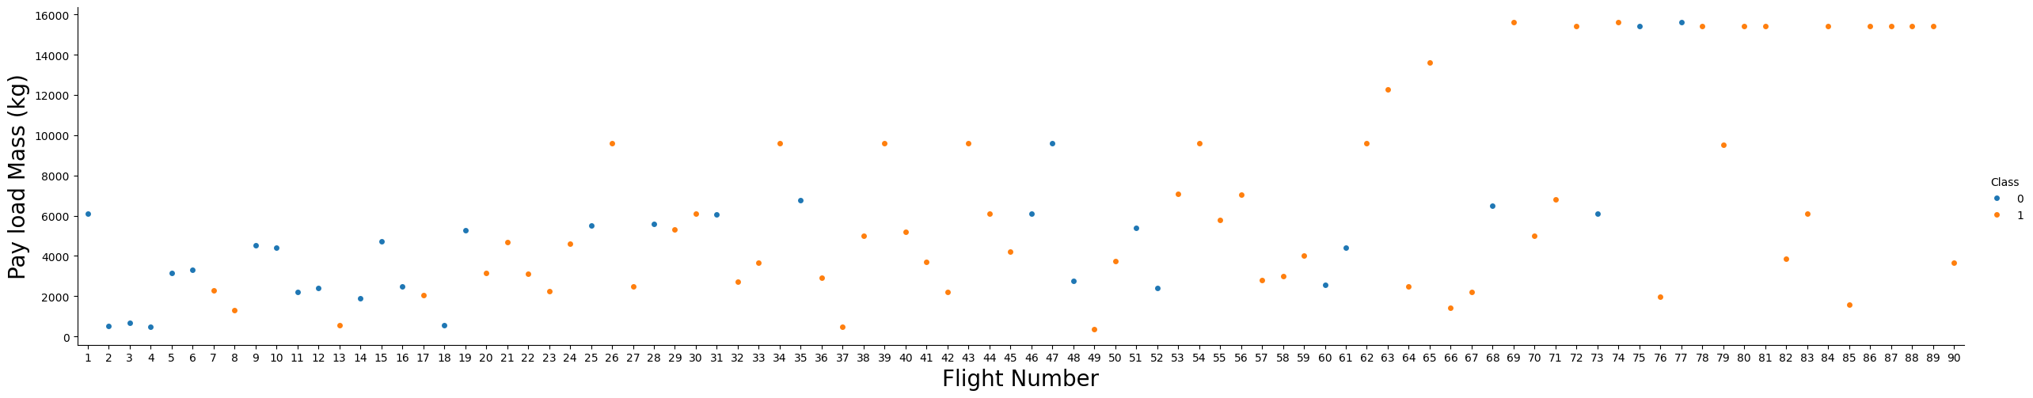
Payload vs. Launch Site
The payload mass for SpaceX missions ranges from very light (around 500 kg) to heavy (over 15,000 kg), with most payloads clustered between 2,000 and 8,000 kg. The success pattern, indicated by color, reveals that earlier flights (lower flight numbers) experienced more failures (Class 0), while later flights (higher flight numbers) achieved more successes (Class 1), demonstrating SpaceX’s improved landing capabilities over time, regardless of payload mass. Additionally, there is a trend toward heavier payloads in later flights, with SpaceX successfully landing first stages even under these more demanding conditions. Successful landings (Class 1) are observed across all payload mass ranges in later flights, highlighting the company’s technological progression. Initially, SpaceX faced more failures even with lighter payloads, but over time, they achieved consistent success with both light and heavy payloads, indicating that their landing technology became more robust and reliable. This visualization effectively showcases SpaceX’s ability to handle increasingly heavy payloads while significantly improving their landing success rates over time.

Slide 22
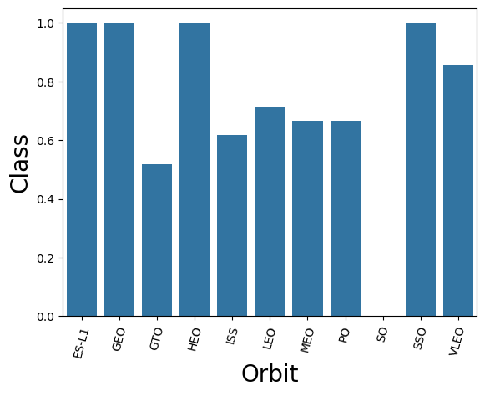
Success Rate vs. Orbit Type
Success rates vary significantly by orbit type, with ES-L1 and ISS achieving near 100% success, while LEO has ~85%, PO ~80%, and SSO and VLEO ~75%. GTO missions are the most challenging, with only a ~50% success rate, due to higher fuel demands, velocity, and energy requirements. HEO has a 0% success rate, though its limited mission frequency makes this less statistically significant. Lower orbits like ISS and LEO generally have higher success rates, while GTO remains a key challenge for SpaceX's reusability goals. These insights can guide mission planning and pricing strategies based on orbit demands.

Slide 23
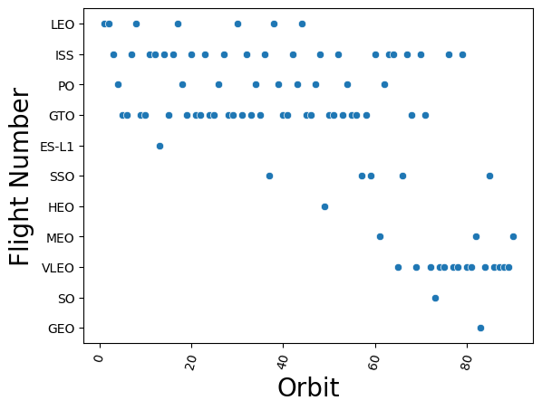
Flight Number vs. Orbit Type
Orbit distribution shows that LEO has been the most frequent orbit type across all flights, with consistent GTO launches, occasional ISS missions, and specialized orbits like SSO and VLEO appearing in later flights. Rare orbits like ES-L1 and HEO are limited to specific missions. Early missions focused on LEO and GTO, while higher flight numbers reflect increased diversity, showcasing SpaceX's expanding capabilities and customer base. The dominance of LEO highlights its commercial importance, while the gradual inclusion of specialized orbits demonstrates SpaceX's technical growth and market adaptation. This evolution highlights their diversification and ability to meet varied customer needs.

Slide 24
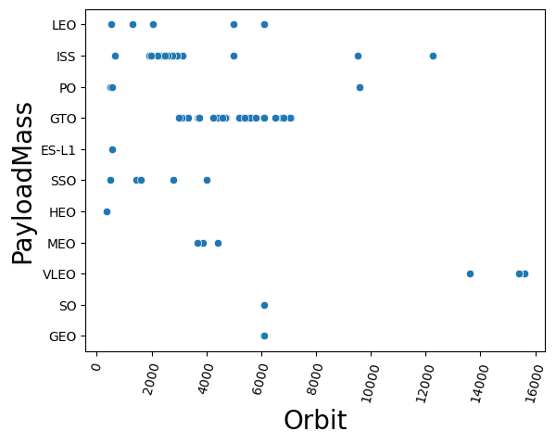
Payload vs. Orbit Type
Payload mass distribution varies significantly across orbit types. LEO offers the widest range, supporting payloads from 500kg to 16,000kg, with most missions falling in the 2,000-8,000kg range, showcasing its flexibility. GTO, constrained by higher energy requirements, typically handles medium-heavy payloads between 3,000-6,000kg. ISS missions are standardized with payloads consistently around 2,000-4,000kg, reflecting its specific cargo needs. SSO shows moderate and consistent payloads of 2,000-5,000kg, while VLEO accommodates the heaviest payloads, clustered around 15,000kg. Lower orbits like LEO and VLEO excel in handling heavier payloads, whereas higher-energy orbits like GTO have stricter payload limits. Specialized orbits such as ISS and SSO highlight the importance of standardization for specific mission requirements.

Slide 25
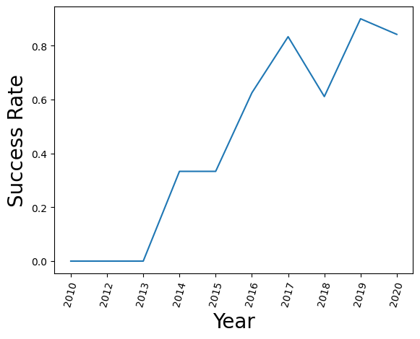
Launch Success Yearly Trend
SpaceX’s success rate has shown a clear upward trend since 2010, starting below 50% during its experimental phase and now exceeding 90% in recent years. From 2010-2012, early attempts had lower success rates as SpaceX refined its landing technology. Between 2013-2015, steady improvements were evident, showcasing technological advancements. Since 2016, success rates have consistently approached near 100%, highlighting a mature and reliable system. This learning curve demonstrates SpaceX’s ability to iterate and improve, reducing costs, boosting customer confidence, and enhancing booster reusability. Their journey reflects the evolution from experimentation to operational excellence.

Slide 26
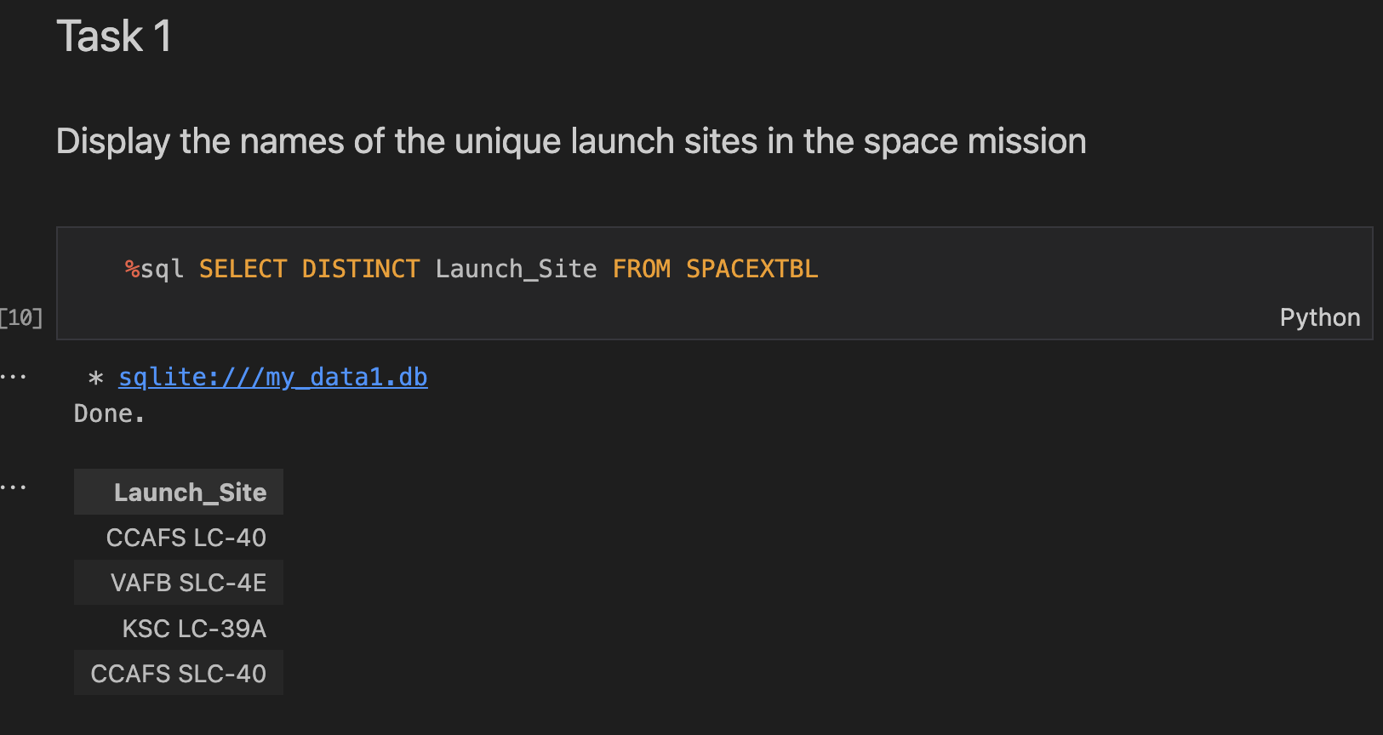
All Launch Site Names
We retrieve the unique names from the launch site using the DISTINCT keyword.

Slide 27
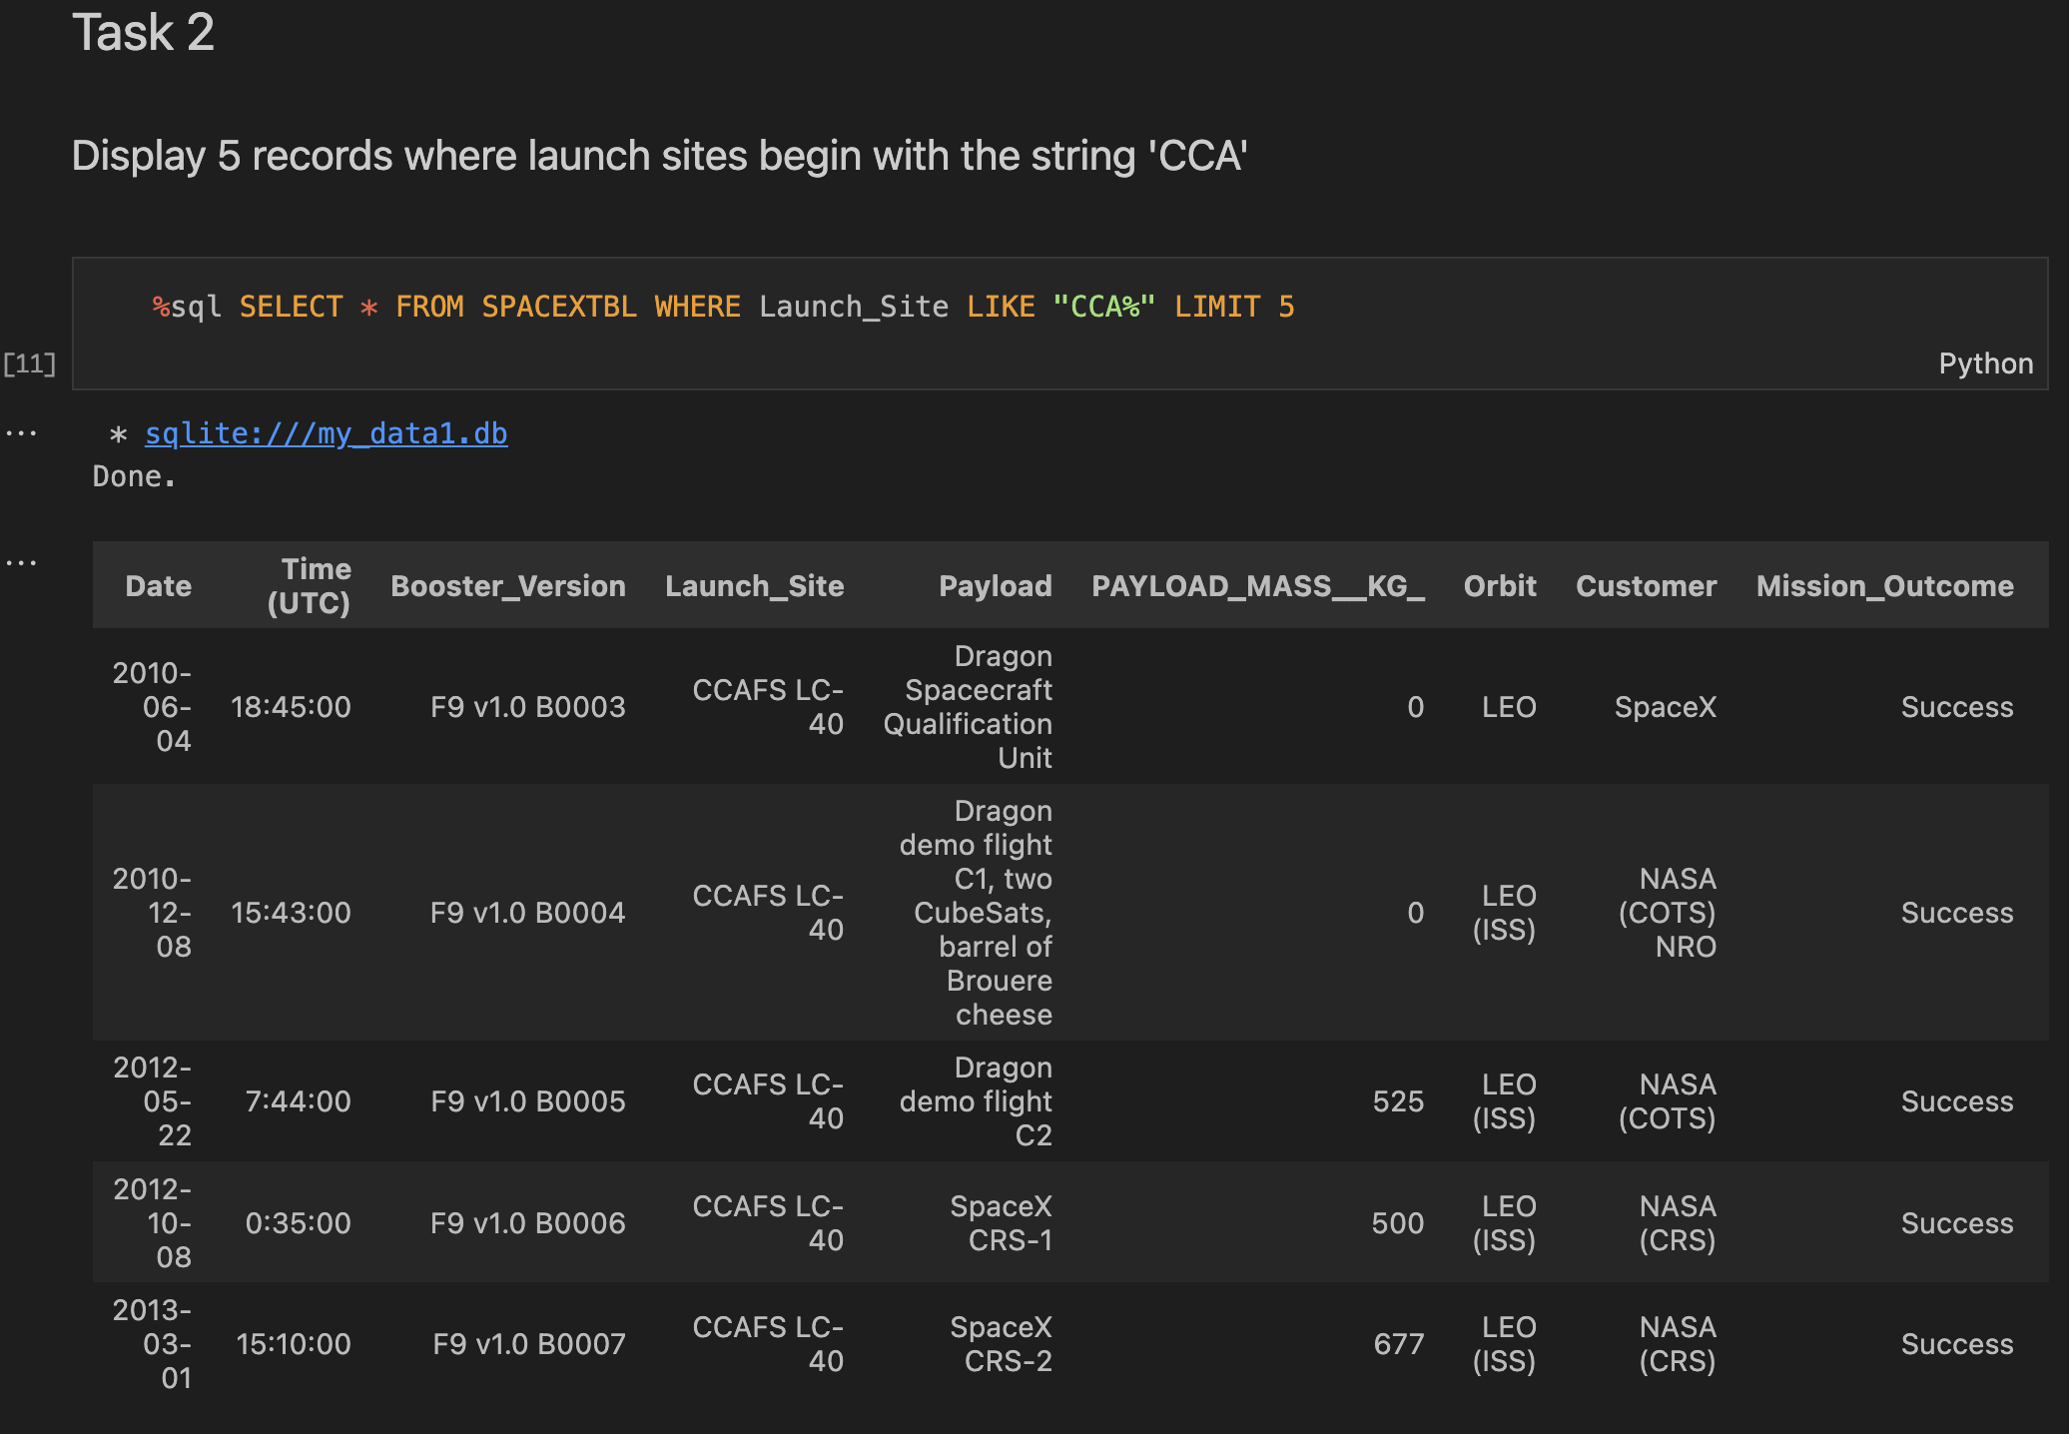
Launch Site Names Begin with 'CCA'
Here we use “LIKE” which allows us to put a string to match some of the characters of what we are looking for, also using "%" to ignore if there are more characters in front of the word.

Slide 28
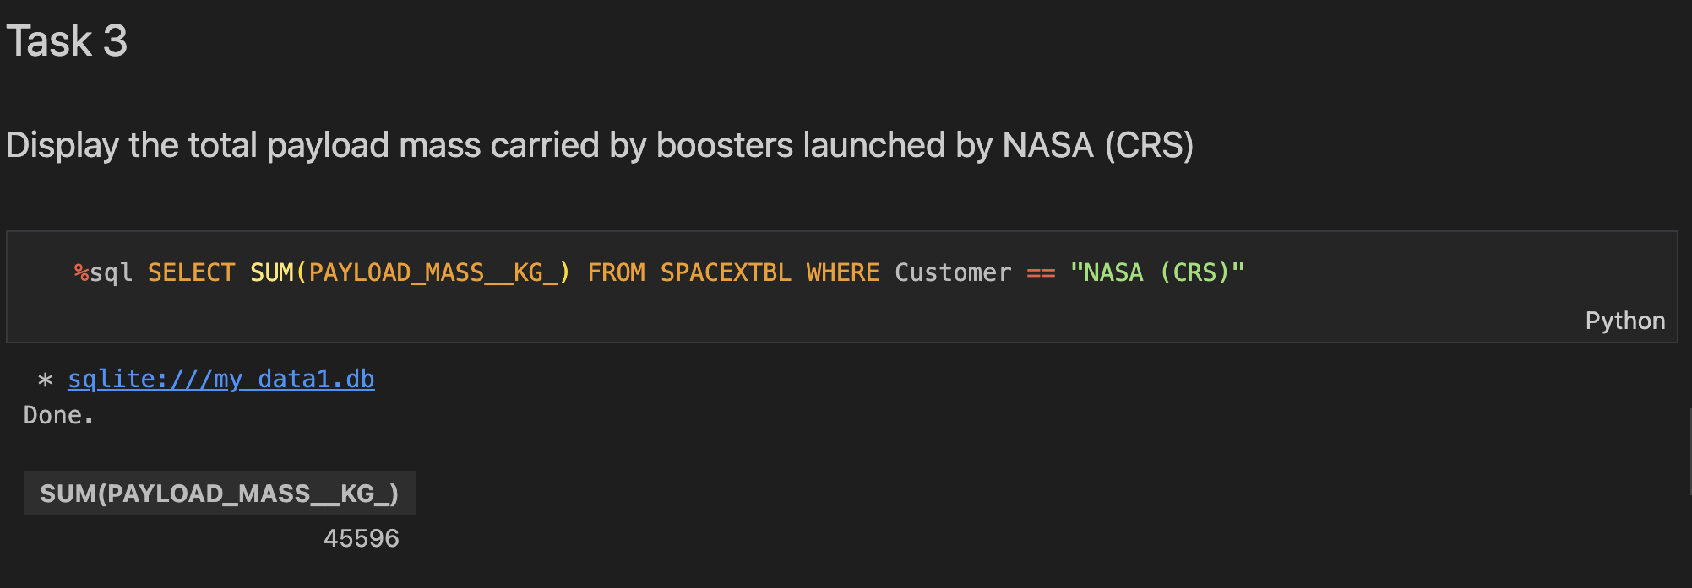
Total Payload Mass
We use "SUM" on the column we are interested in to add everything and we use "WHERE" to filter that the customer is the one we are interested in.

Slide 29
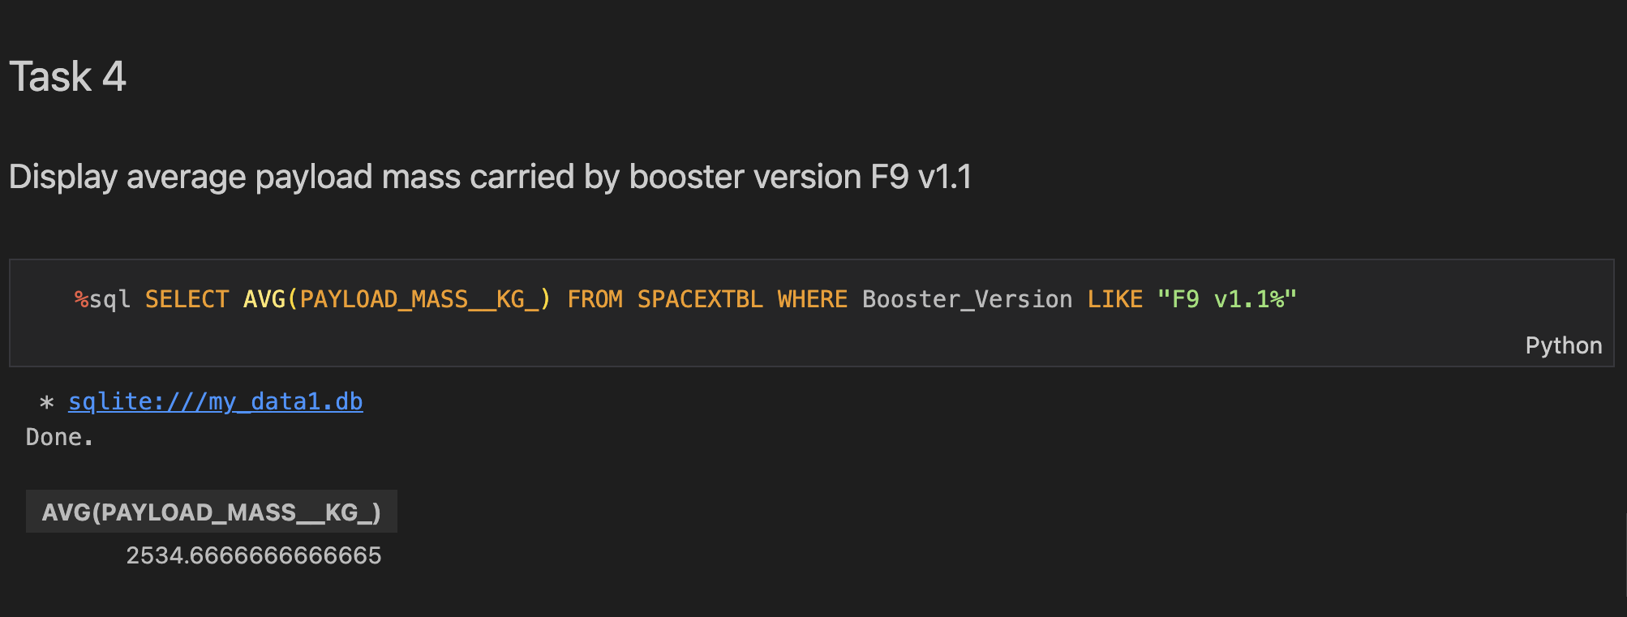
Average Payload Mass by F9 v1.1
We use "AVG" on the column of interest and "LIKE" to filter the booster version to the appropriate one.

Slide 30
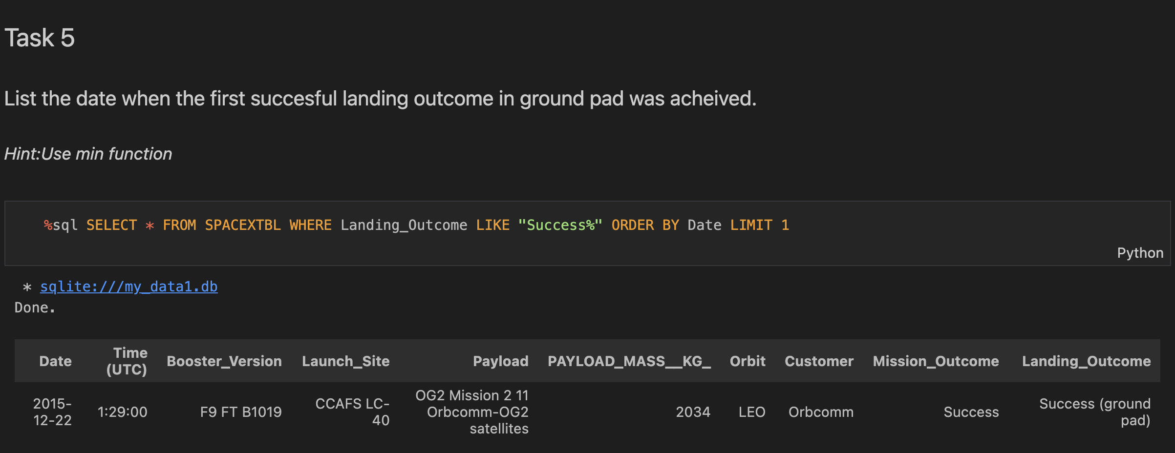
First Successful Ground Landing Date
We use "LIKE" to filter the successes, we use "ORDER BY" to sort by date from lowest to highest and we limit it to one which in the end will give us the first date that was successful.

Slide 31
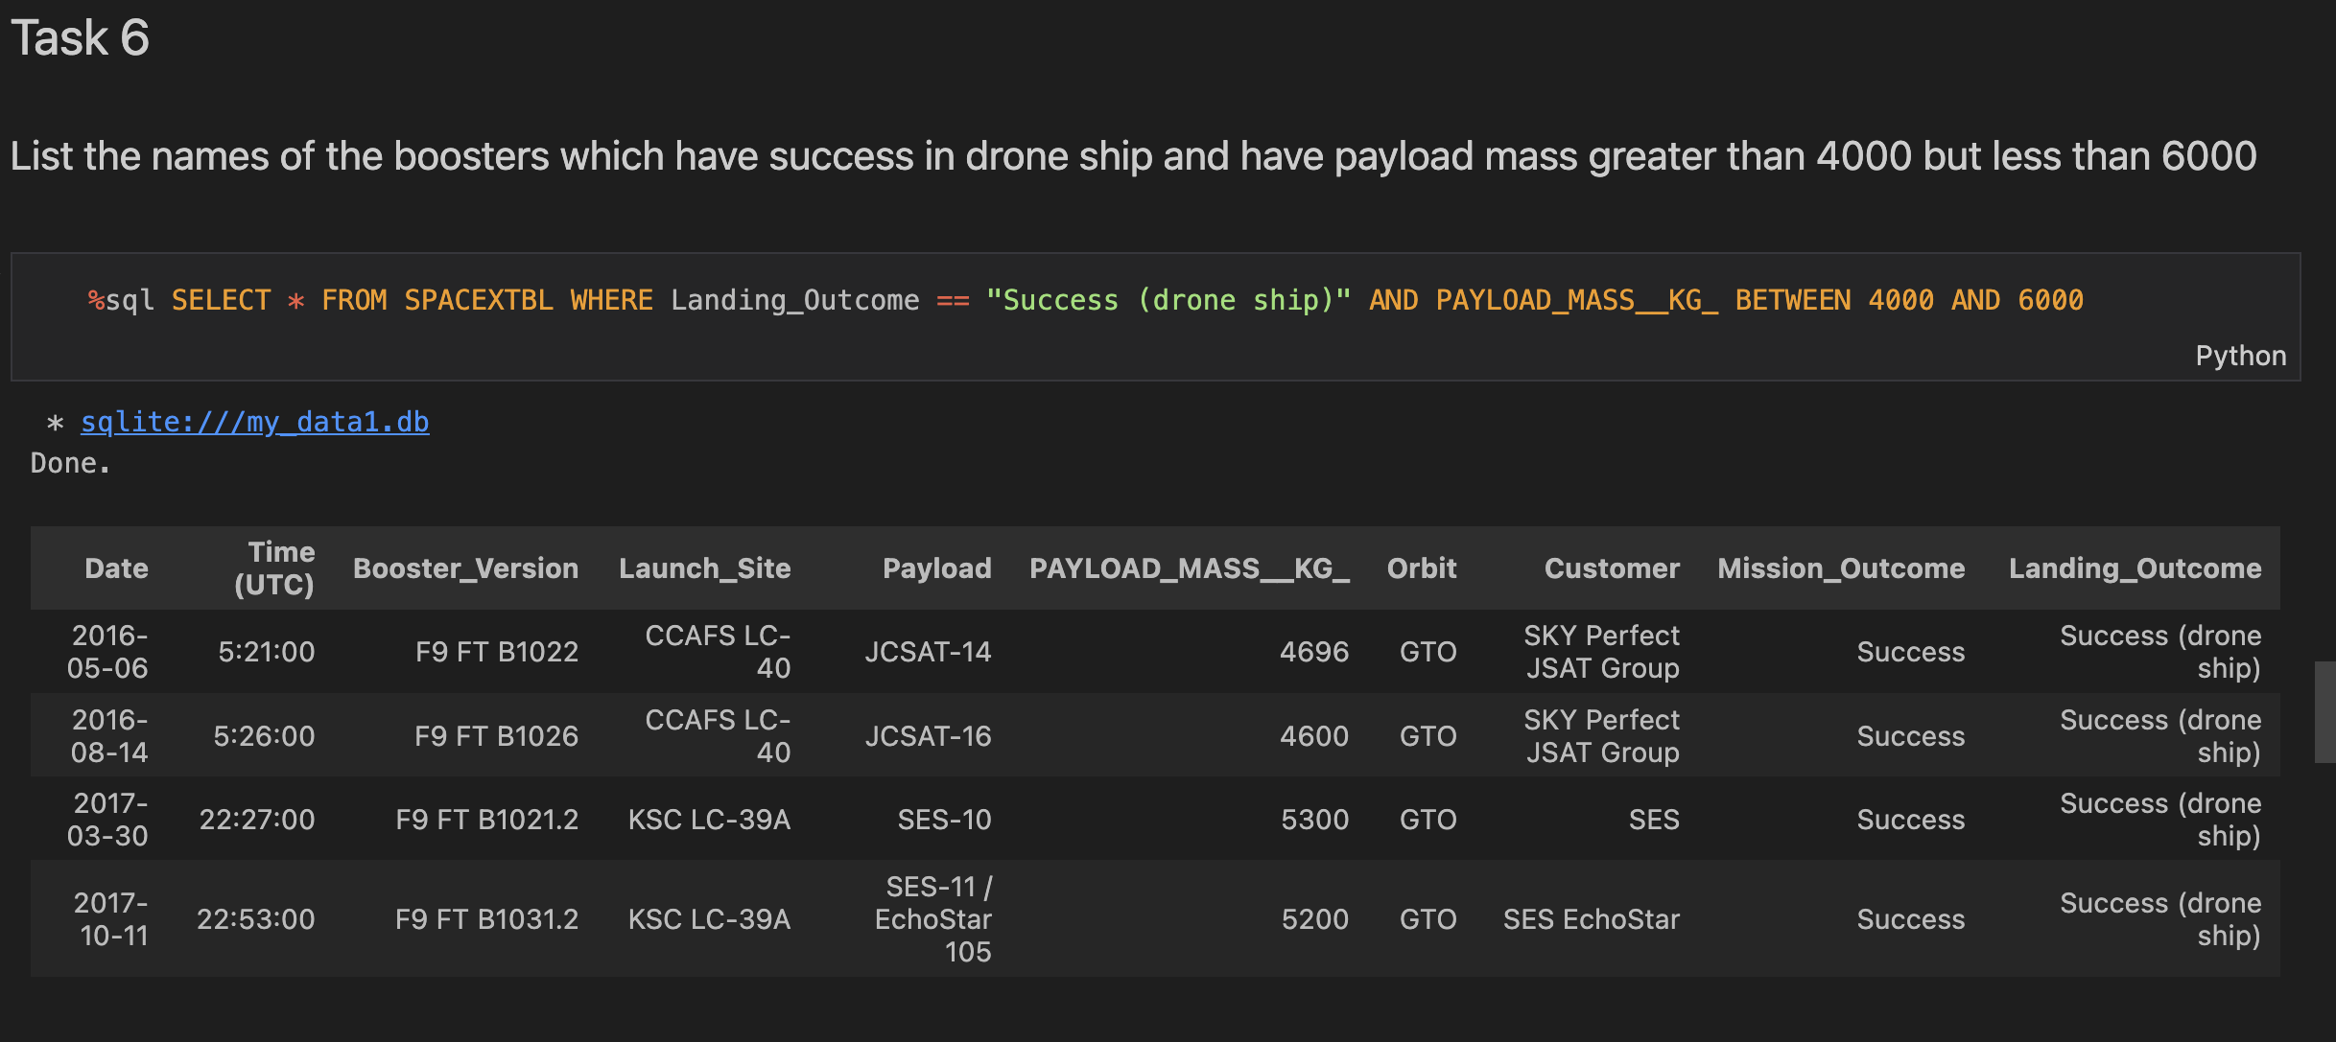
Successful Drone Ship Landing with Payload between 4000 and 6000
Here we use "BETWEEN" to search for successful drone landing outcomes that have a weight between 4000 to 6000 KG.

Slide 32
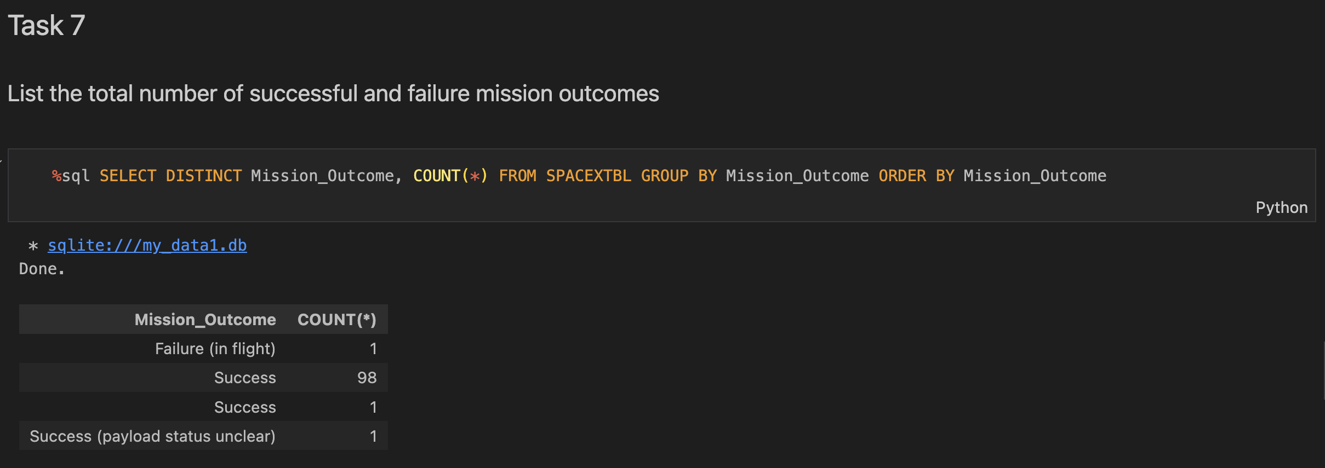
Total Number of Successful and Failure Mission Outcomes
"DISTINCT" to have mission outcomes without repetitions and "COUNT" to count how many of each type of outcome there are.

Slide 33
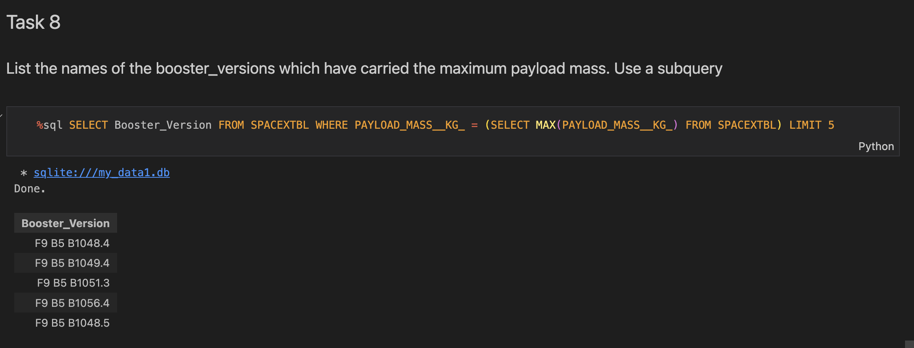
Boosters Carried Maximum Payload
We select the booster versions that meet the maximum weights returned by the subquery.

Slide 34
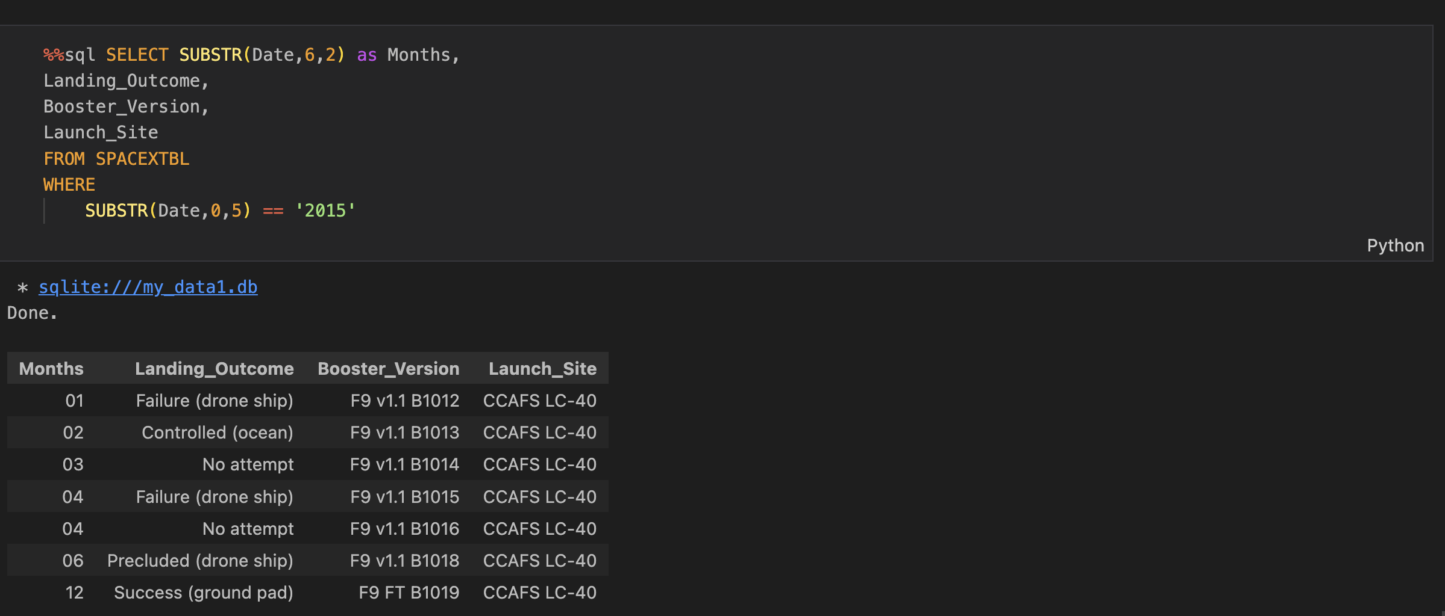
2015 Launch Records
We use ”SUBSTR” twice, retriving all the launches in every month in 2015.

Slide 35
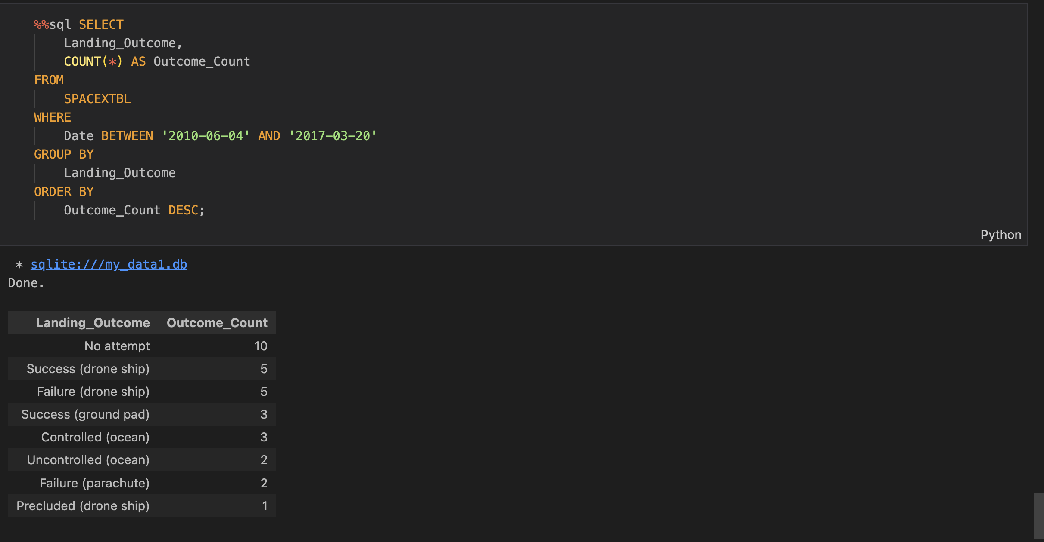
Rank Landing Outcomes Between 2010-06-04 and 2017-03-20
Between the two dates we are grouping by Landing Outcome and counting each one for each class of outcomes.

Slide 36

Section 3

Slide 37
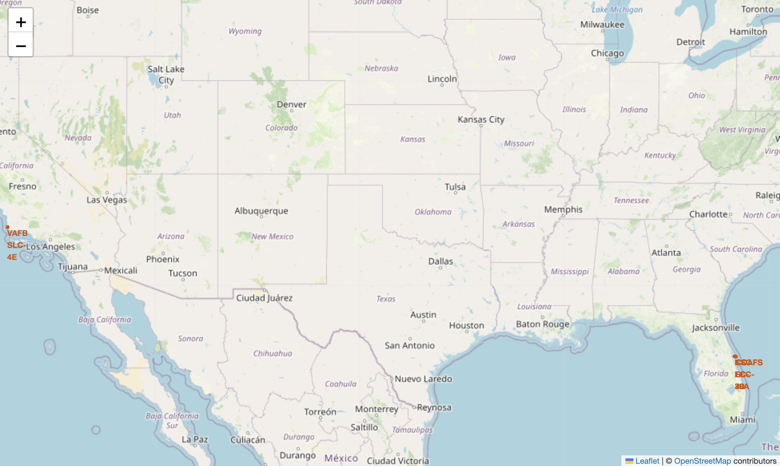
Launch Sites Locations in the map
Here, we display all the launch sites on the Folium map. The only launch site on the west coast of the United States is VAFB SLC 4E, while the others are located on the east coast.

Slide 38
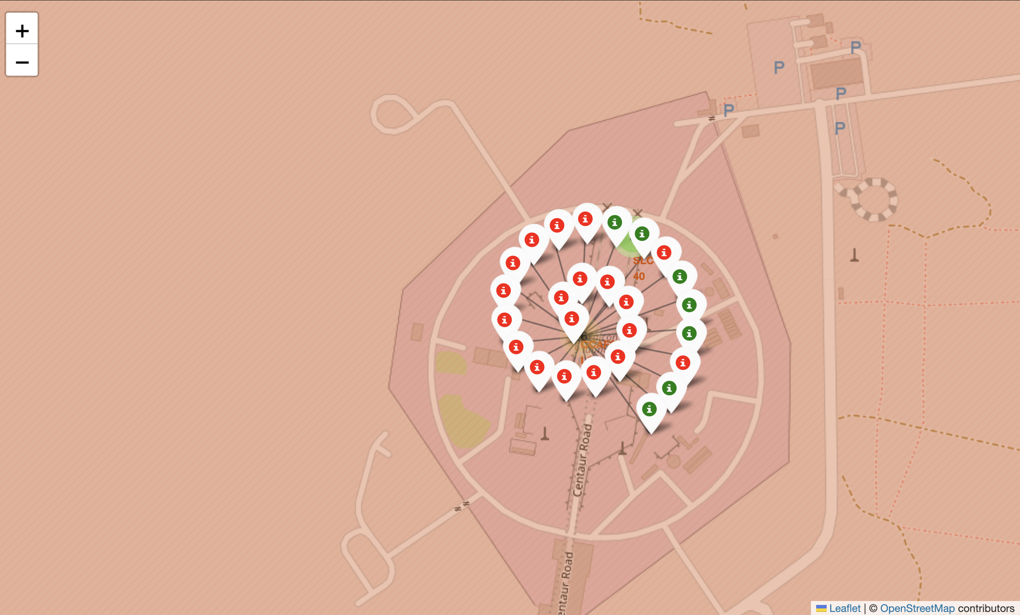
Launch Sites Outcomes
Here we mark all the Success (Green) and Failed (Red) launch sites.

Slide 39
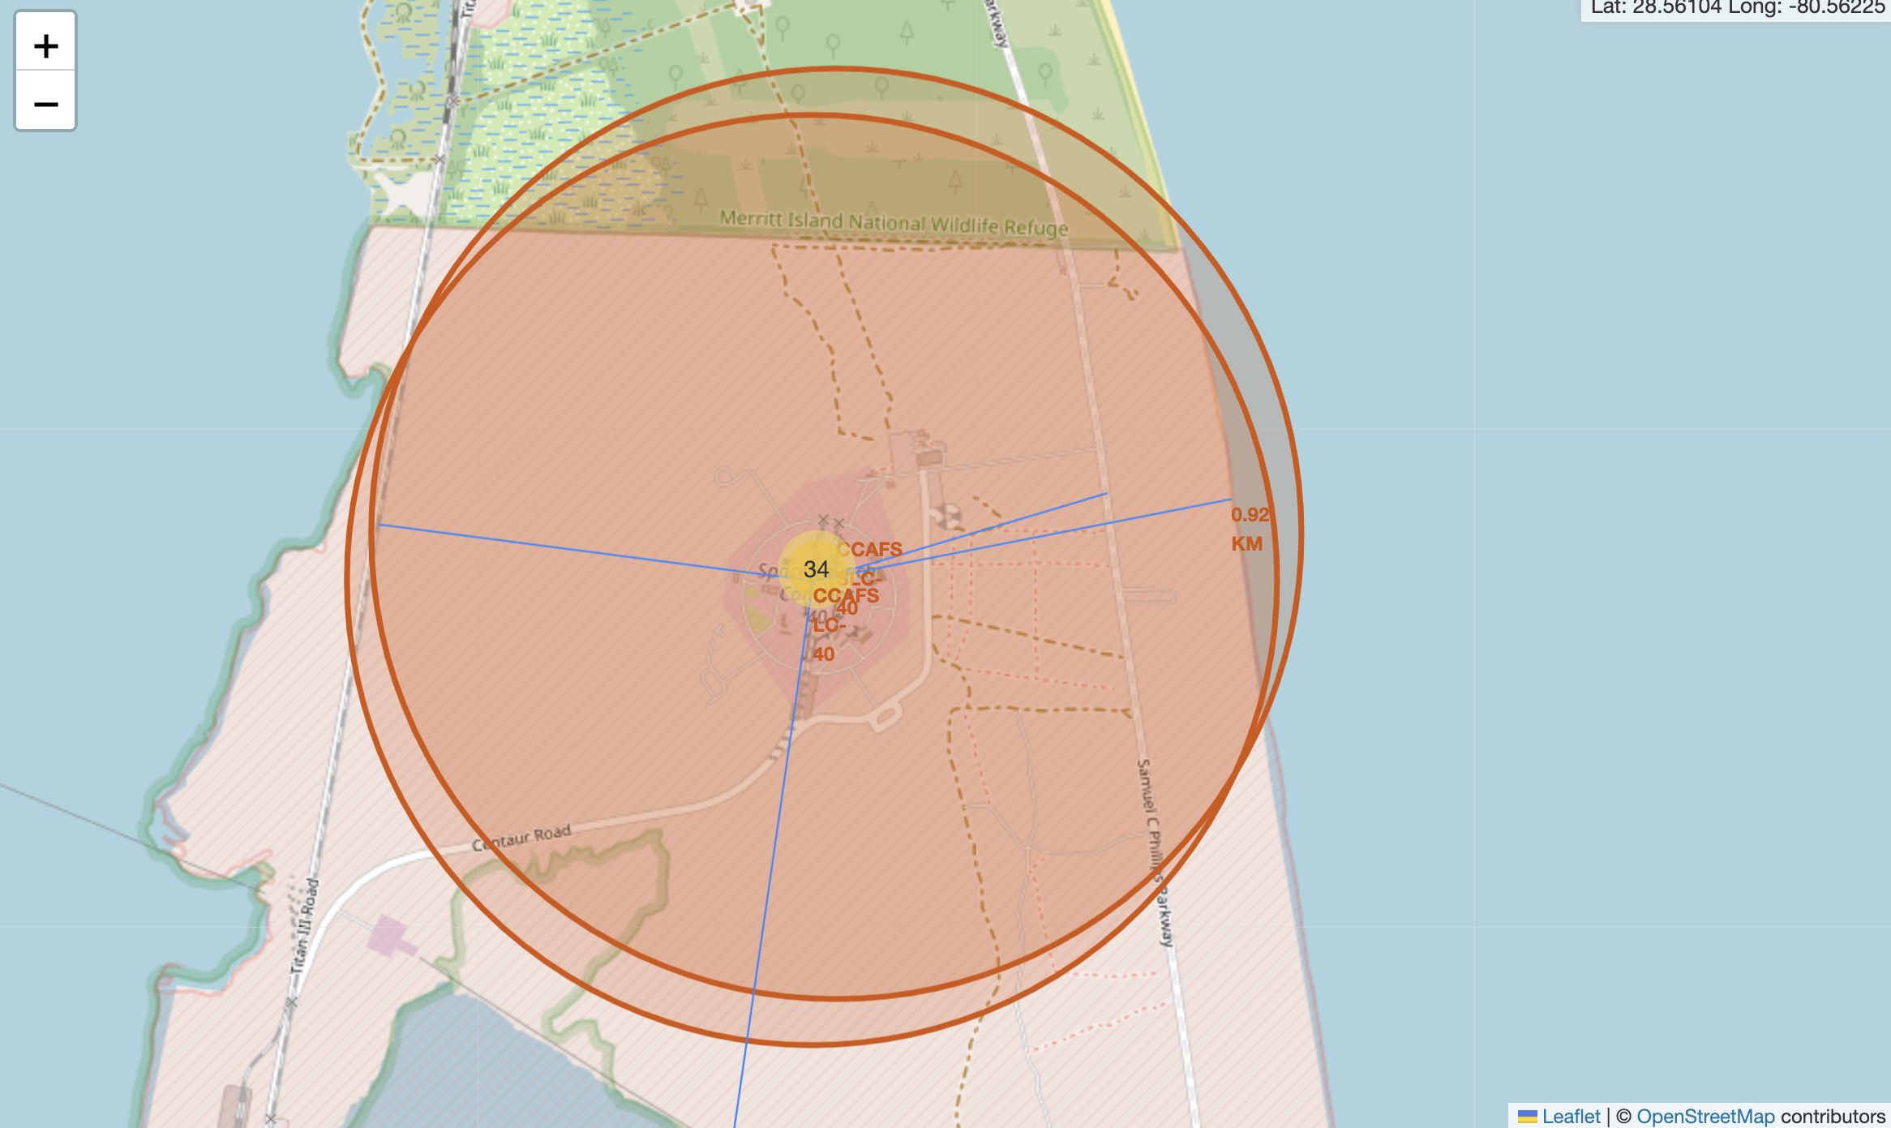
Nearest Places to Launch Site
Here, we display lines connecting the launch site to the nearest highway, cities, and coast. For example, this launch site is 0.92 km from the coast.

Slide 40

Section 4

Slide 41
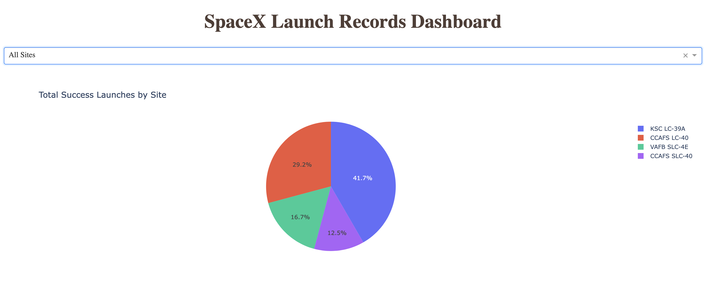
Total Success Launches By Site
We can observe each site and the success percentage.

Slide 42
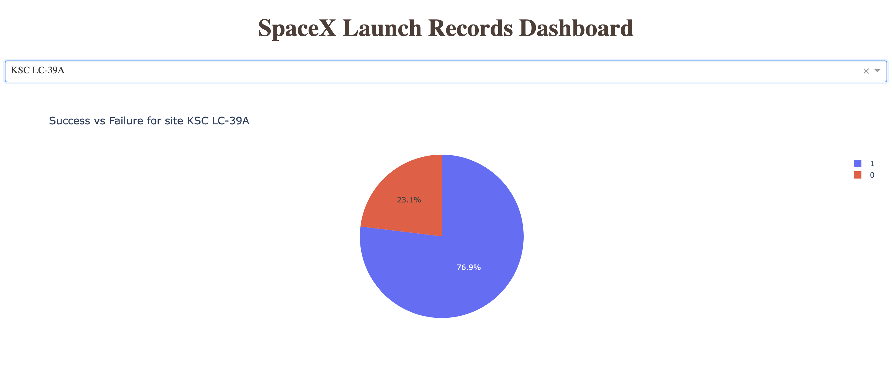
KSC LC-39A Most Success Site
We see here the site with the better success rate with 76.9%.

Slide 43
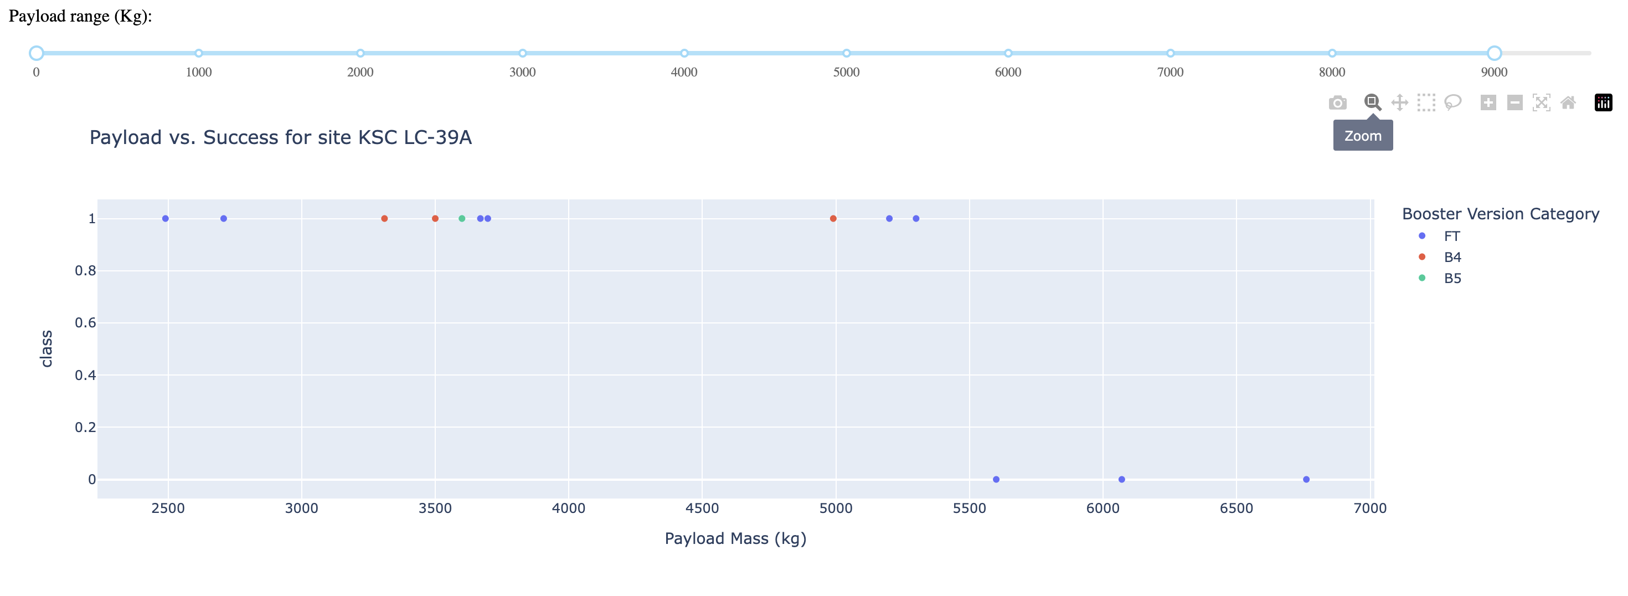
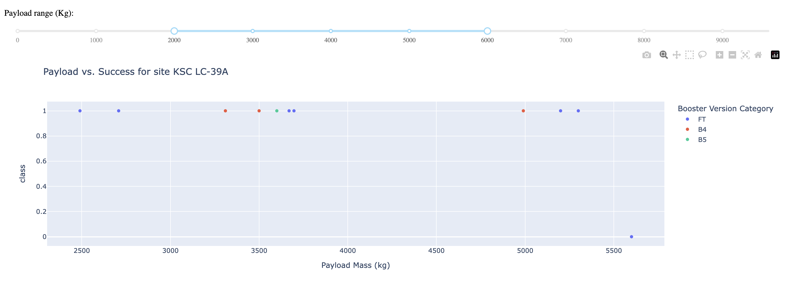
<Dashboard Screenshot 3>
Here we can see for KSC LC-39A that it have a better success rate between 2500 and 5300 of payload mass.

Slide 44

Section 5

Slide 45
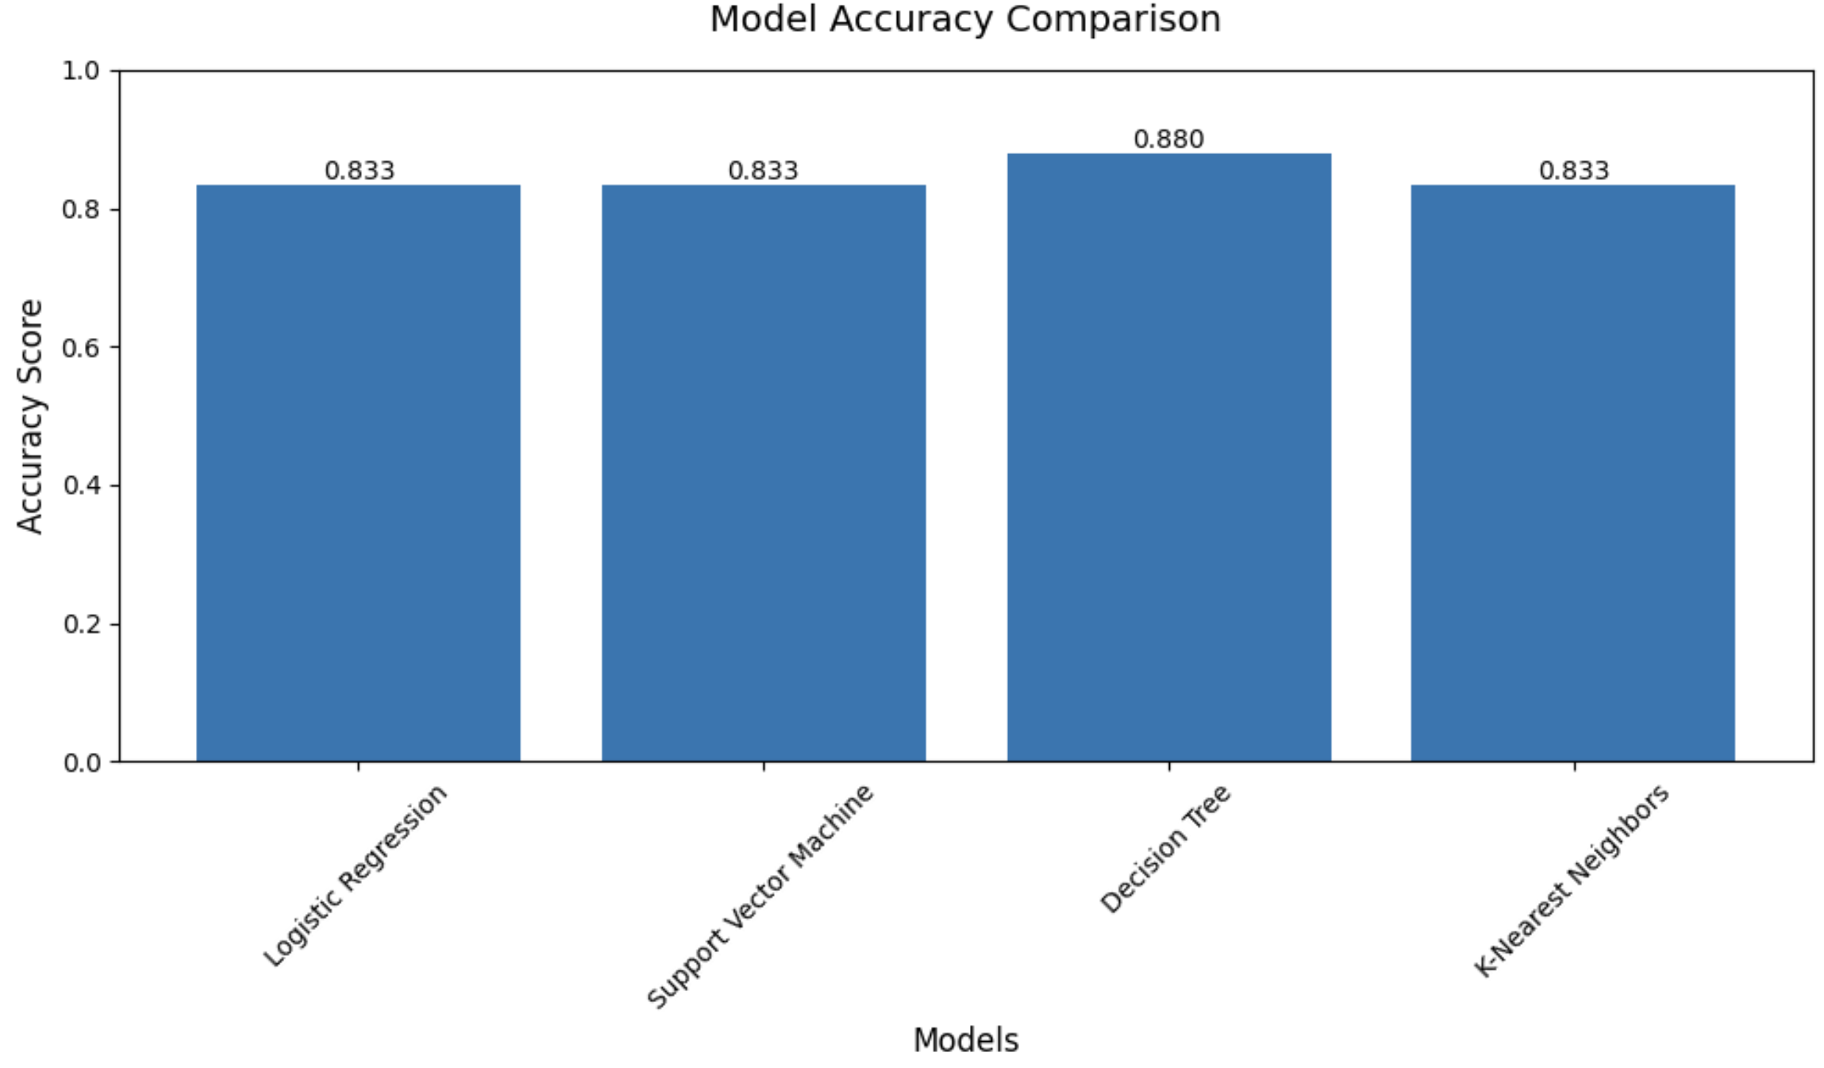
Classification Accuracy
We can observe that Decision Tree wins for accuracy with a 0.88.

Slide 46
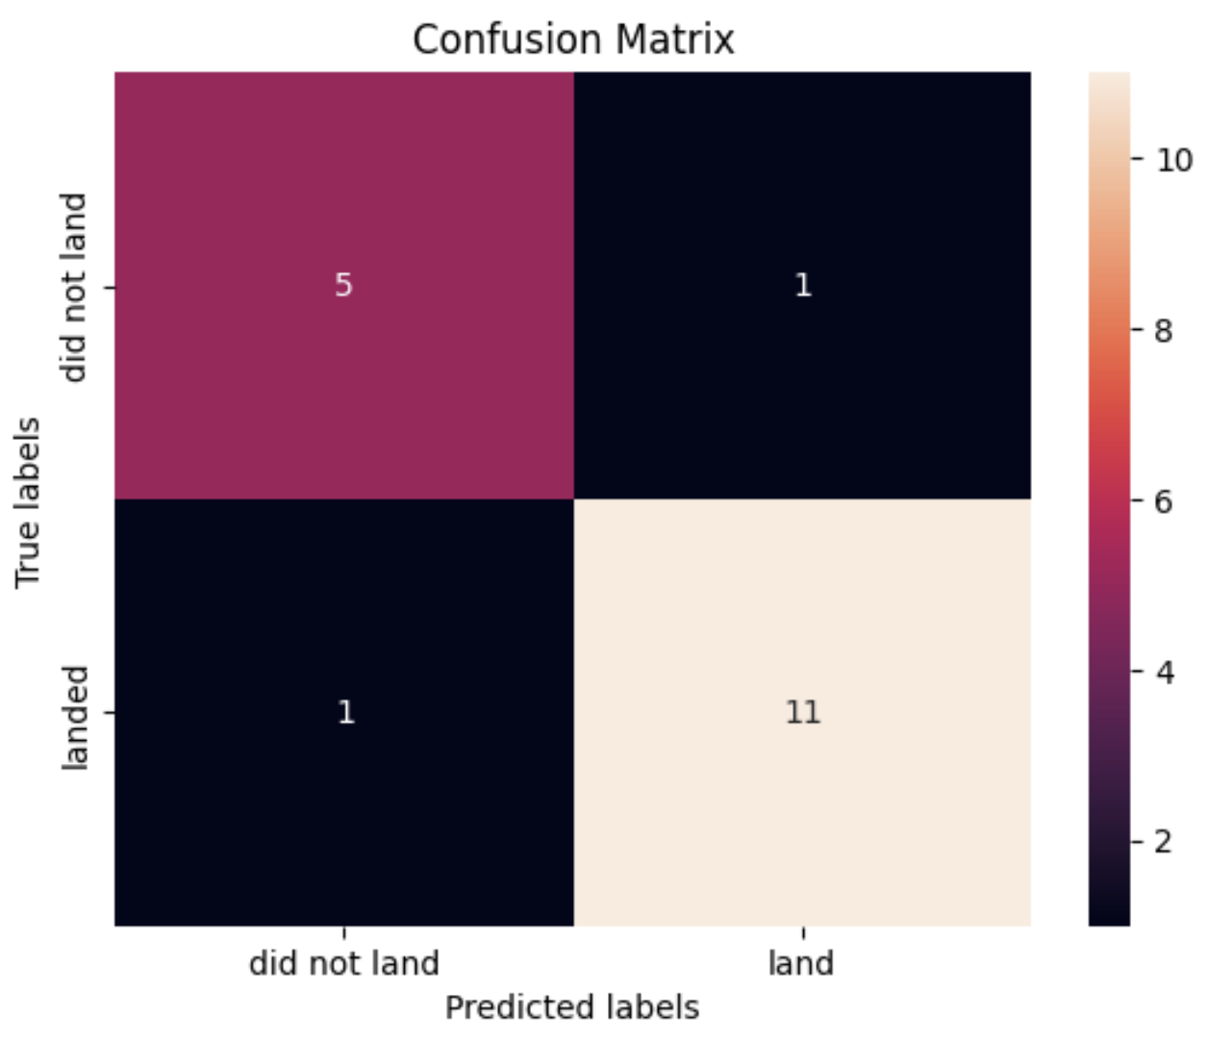
Confusion Matrix
The Decision Tree achieved 0.888% accuracy, making it the best-performing model. It correctly classified all five "Did Not Land" cases, with only one false positive. For "Landed" cases, it accurately predicted 11 out of 12, with just one false negative. Compared to other models, it had fewer errors, especially in false positives, which are more costly for mission planning. Its ability to define clear decision boundaries makes it the most reliable model for predicting SpaceX rocket landings and estimating launch costs.

Slide 47
Conclusions
Point 1
Point 2
Point 3
Point 4
…

Slide 48
Appendix
Include any relevant assets like Python code snippets, SQL queries, charts, Notebook outputs, or data sets that you may have created during this project

Slide 49


